Slide 1
Translation and Spectacle Μετάφραση και Θέαμα
Maria Sidiropoulou
School of Philosophy
Faculty of English Language and Literature
2015

Slide 2
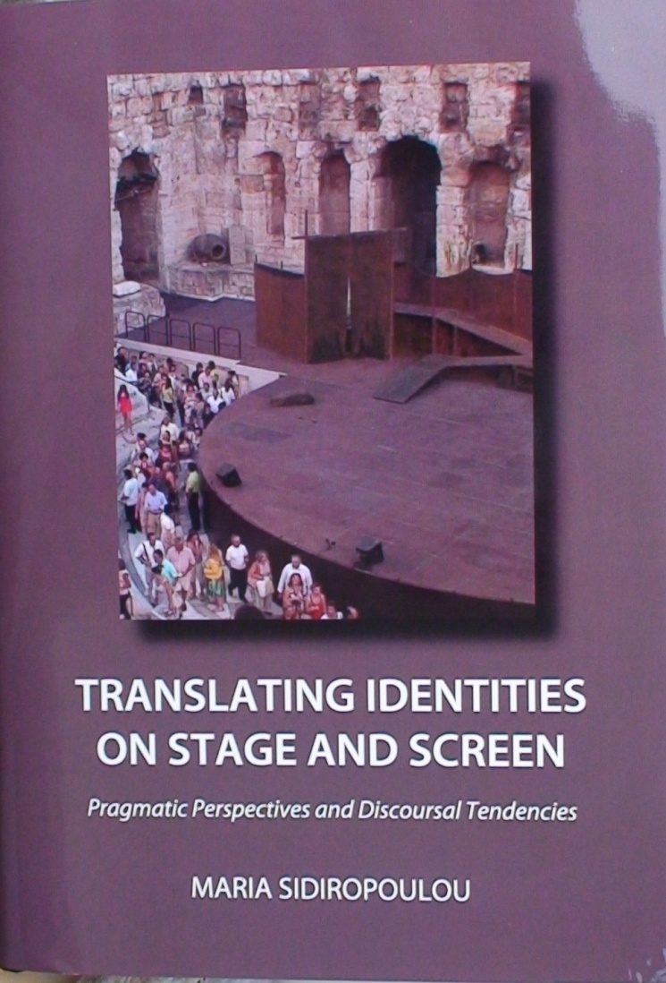
Source:
Sidiropoulou, Maria.
2012/2013.
Translating Identities on Stage and Screen – Pragmatic perspectives and discoursal tendencies.
Newcastle-upon-Tyne: Cambridge Scholars
http://www.cambridgescholars.com/translating-identities-on-stage-and-screen-18

Slide 3
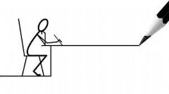
Unit 9:
Maria Sidiropoulou
School of Philosophy
Faculty of English Language and Literature
Translation Studies perspectives:
linguistic and literary

Slide 4
Aims of unit 9
To raise awareness of the contribution of linguistic theory to analyzing spectacle data
To confirm the three approaches to spectacle data taken in this course
To raise awareness of parameters which may affect translation decision-making in the spectacle

Slide 5
Contents of unit 9
Translation and dimensions of context (Hatim & Mason 1990)
Approaches to translation data
Literary texts vs. linguistic tools
Opera surtitling
Bourdieu’s symbolic/cultural capital and translation

Slide 6
Dimensions of context (adapted from Hatim and Mason 1990:58) Translation as…
Text
Structure
Texture
Pragmatic Action
Semiotic Interaction
Communicative transaction
CULTURE
IDEOLOGY

Slide 7
Dimensions of context Translation as…Communicative transaction
COMMUNICATIVE TRANSACTION
User: Idiolect,Dialect, etc
Use: Field, Mode, Tenor
Dialect/register rendering, in English-Greek theatre/film translation
Issues of social stratification and
class identity in interlingual transfer, as manifested in rendering Pygmalion into Greek.
Text
Structure
Texture
Pragmatic Action
Semiotic Interaction
Communicative transaction
IDEOLOGY
CULTURE

Slide 8
Dimensions of context Translation as…Pragmatic action
PRAGMATIC ACTION
Speech Acts, Implicatures
Presuppositions, Text Act etc.
Rendition of politeness in another language (as manifested in translating Pinter) and the verbal communication styles (examined in Da and The Importance of Being Earnest) fall into the pragmatic dimension of context.
Text
Structure
Texture
Pragmatic Action
Semiotic Interaction
Communicative transaction
CULTURE
IDEOLOGY

Slide 9
Dimensions of context Translation as…Semiotic interaction
SEMIOTIC INTERACTION
Word, Text, Discourse ,Genre
Intertextuality
The interpretation perspectives manifested in the translation of stage versions of Hamlet touch upon ideological and semiotic aspects of meaning-making. Part
of the message is transferred through semiotic systems other than discourse
Text
Structure
Texture
Pragmatic Action
Semiotic Interaction
Communicative transaction
CULTURE
IDEOLOGY

Slide 10
approaches to translation data
 | 1 | 2 | 3
APPROACHES | functionalist | interpretive | critical
RELATED DISCIPLINES | Social sciences Psychology | Anthropology Sociolinguistics | Politics C.D.A.
METHODS | quantitative | qualitative | textual

Slide 11
The approach in the book vs. perspectives to intercultural communication
The approach of the book was functionally oriented in that it examined describable social reality. It had a qualitative and quantitative orientation, in that it explored systematically occurring variation in mediator behaviour.
The approach took an interpretive perspective accounting for sociolinguistic and anthropological variation, as described in intercultural research.
At points, the study drew on critical perspectives to intercultural communica-tion in that it sought to uncover power differentials that affect translation process and product. It revealed shifts in the power of mediator to inscribe identities on texts…
APPROACHES | functionalist | interpretive | critical
RELATED DISCIPLINES | Social sciences Psychology | Anthropology Sociolinguistics | Politics C.D.A.
METHODS | quantitative | qualitative | textual

Slide 12
Literary production vs. linguistic tools
In the 1980’s, developments in pragmatics and discourse analysis allowed stylisticians to focus on the linguistic structure of dramatic dialogue
In examining issues like politeness, register and pun rendition, identity inscription and value implementation, in target texts, the course extends the potential investigated in the above research projects to the study of drama and film dialogue in translation

Slide 13
William Golding’s The Inheritors
Halliday applied developments in systemic functional grammar, on Golding’s novel The Inheritors, to show how ideational patterns (language used to convey experience and information about the context) can be used to imply a specific point of view in prose (Culpeper et al 1998).
The Inheritors (William Golding)
http://www.enotes.com/topics/inheritors
http://en.wikipedia.org/wiki/The_Inheritors_(William_Golding)

Slide 14
John Osborn’s Look back in Anger
Herman (1998) explored the insights of Conversation Analysis on the study of drama. She examined the contribution that turn-taking patterns made to understanding situations and characters in plays. In analyzing an extract from John Osborn’s Look back in Anger, she showed that turn-taking choices (e.g. length of turns, pauses, interruptions etc.) affect the reader’s interpretation of characters’ discourse.
Look Back In Anger - 1989 - Kenneth Branagh Emma Thompson FULL https://www.youtube.com/watch?v=-Jt9ZXgTOEE

Slide 15
Theatre of the Absurd
Simpson (1998) employs linguistic tools for the analysis of “odd talk”. Odd talk is a clear aspect of absurdity in the work of a group of dramatists writing in the 1950s and early 1960s, which critics have called the Theatre of the Absurd (including Harold Pinter, Eugene Ionesco, Edward Albee, N.F. Simpson and Samuel Beckett).
Simpson showed that odd talk often “involves taking the assumptions and patterns from one discourse context and using them in another where they would not normally be found” (ibid:34)

Slide 16
Shakespeare’s The Taming of the Shrew
Cooper (1998) employed Grice’s model to show how we can reconstruct inferential chains that lead to a particular interpretation, in Shakespeare’s The Taming of the Shrew. She showed how linguistic inferences generated via Grice’s model interact with inferences based on the conventions of a particular genre (e.g. the farce) and culture (e.g. courtship) to produce different interpretations (ibid:54).
Taming of the Shrew - Best Bits https://www.youtube.com/watch?v=oXUelJZSPxY

Slide 17
Tom Stoppard’s Professional Foul
Bennison (1998) also used developments in discourse analysis and pragmatics to analyze the behaviour of characters in Tom Stoppard’s play Professional Foul, by focusing on four character traits.
Professional Foul http://en.wikipedia.org/wiki/Professional_Foul

Slide 18
Scent of a Woman
Culpeper (1998) explores impoliteness in film dialogue by analysing the behaviour of two main characters in the film Scent of a Woman. He argued that impoliteness in the film generates the conflict that attracts audience attention and moves the plot forward.
The Tango - Scent of a Woman (4/8) Movie CLIP (1992) HD https://www.youtube.com/watch?v=F2zTd_YwTvo

Slide 19
Shakespeare’s Macbeth
Freeman (1998) applied cognitive theory of metaphor to Shakespeare’s Macbeth. He suggested that the play is based on the PATH and CONTAINER schemata and shows how the two schemas interact to create a four-dimensional image of Macbeth’s downfall.
MACBETH BBC SHAKESPEARE COLLECTION https://www.youtube.com/watch?v=lmiEH6E63UM

Slide 20
David Mamet’s Oleanna
Weber (1998) focused on the interaction of the social context (power relations) and cognitive context (conceived as “schemata”) to show how our interpretations of the dialogue are affected by our assumptions. Weber discussed changing power relations between a university teacher and a student in David Mamet’s Oleanna to identify three models of power relations.
[Full Movie] Oleanna (1994) https://www.youtube.com/watch?v=P2KFG4ZibCQ

Slide 21
Arthur Miller’s The Crucible
Lowe (1998) employed Austin and Searle’s speech act theory to analyze ‘unhappy’ confessions in Arthur Miller’s The Crucible. Lowe showed how the discourses of two characters in the play are interpreted differently by the other characters and the reader.
The Crucible https://www.youtube.com/watch?v=o3hDrTAmDH0

Slide 22
Opera surtitling Jacques Offenbach’s Les Contes d’ Hoffmann Greek surtitles by P. Christogiannopoulou, National Opera House, Athens
Offenbach, J. Les Contes d’Hoffmann
Offenbach, J. The Tales of Hoffmann
Ho ho! Obedient, modest and beautiful! (aside) Thanks to her I’ll be able to make up the five hundred ducats that I’ve lost through Elias the Jew’s bankruptcy!
Eh! Eh! Sage, modeste et belle! (à part) Je retrerai par elle, dans les cinq cents ducats que la banqueroute du juif Elias me coûte!
Ζ. Όφενμπαχ
Τα Παραμύθια του Χόφμαν
Φρόνιμη, σεμνή και όμορφη. Μ’ αυτήν θα ξαναπάρω τα πεντακόσια δουκάτα που μου στοίχισε η χρεωκοπία του εβραίου Ελιάς

Slide 23
Bourdieu’s symbolic/cultural capital
Hermans (1999) describes Gouanvic’s attempt [1997] to account for the status and prestige (‘symbolic/cultural capital’ in Bourdieu’s sense) of cultural products when they enter a new environment through translation
By ‘cultural capital’, he means all three forms of it, in Bourdieu’s sense, namely,
the “long-lasting dispositions of the mind and body” (embodied form, ibid: 82),
the cultural goods available, like pictures, books, instruments, dictionaries etc (objectified form), and
the objectification obtained through educational qualifications (institutionalized form).

Slide 24
Unit 9 has …
raised awareness of the contribution of linguistic theory to analyzing spectacle data
confirmed the three approaches to spectacle data taken in this course
raised awareness of parameters which may affect translators’ decision-making in the spectacle

Slide 25
References 1/2
Attardo, Salvatore. 2001. Humorous Texts: A Semantic and Pragmatic Analysis. Berlin/New York: Mouton de Gruyter.
Baker, Mona. 2006. Translation and Conflict – A Narrative Account. London: Routledge.
Bassnett, Susan. 1998. “Researching Translation Studies” in Bush, Peter and Kirsten Malmkjær (eds) Rimbaud’s Rainbow. 105-118. Amsterdam: John Benjamins.
Bennison, N. 1998. “Accessing Character through Conversation: Tom Stoppard’s Professional Foul” in Culpeper Jonathan, Short Mick and Peter Verdonk (eds) Exploring the Language of Drama. 67-82. London: Routledge.
Brown, Penelope and Stephen Levinson. 1978/1987. Politeness: Some universals in Language Usage. Cambridge: Cambridge University Press.
Brown, Roger and Albert Gilman. 1989. “Politeness theory and Shakespeare’s four major tragedies”. Language in Society. 18: 2. 159-212.
Chesterman, Andrew. 1997. Memes of Translation. Amsterdam: John Benjamins.
Culpeper, Jonathan. 1998. “(Im)politeness in Dramatic Dialogue” in Culpeper Jonathan, Short Mick and Peter Verdonk (eds) Exploring the Language of Drama. 83-95. London: Routledge.
Freeman, Donald C. 1995. “‘Catch[ing] the nearest way’: Macbeth and Cognitive Metaphor” in Culpeper Jonathan, Short Mick and Peter Verdonk (eds) Exploring the Language of Drama. 96-111. London: Routledge.
Gibbs, A. M. 1983. The Art and Mind of Shaw. London: MacMillan.
Grene, Nicholas. 1984/1987. Bernard Shaw – A Critical View. London: Mac Millan.

Slide 26
References 2/2
Gudykunst, William B., and Stella Ting-Toomey. 1988. Culture and Interpersonal Communica-tion. Newbury Park, CA: Sage.
Hale, Terry and Carole-Anne Upton. 2000. “Introduction” in Upton Carole-Anne (ed) Moving Target – Theatre Translation and Cultural Relocation. 1-13. Manchester: St. Jerome.
Hatim, Basil and Ian Mason. 1990. Discourse and the Translator. London and New York: Longman.
Hermans, Theo. 1999. Translation in Systems – Descriptive and System oriented Approaches Explained. Manchester: St Jerome.
Katan, David. 1999. Translating Cultures. An Introduction for Translators, Interpreters and Mediators. Manchester: St Jerome.
Lefevere, Andre. 1998. “Acculturating Bertolt Brecht” in Bassnett, Susan and Andre Lefevere (eds) Constructing Cultures – Essays on Literary Translation. 109-122. Clevedon: Multilingual Matters.
Lowe, Valerie. 1998. “‘Unhappy’ Confessions in The Crucible: a Pragmatic Explanation” in Culpeper Jonathan, Short Mick and Peter Verdonk (eds) Exploring the Language of Drama. 128-141. London: Routledge.
Sidiropoulou Maria. Translating Identities on Stage and Screen. Pragmatic perspectives and discoursal tendencies. Newcastle-upon-Tyne: Cambridge Scholars.
Simpson Paul. 1998. “Odd Talk: Studying Discourses of Incongruity” in Culpeper Jonathan, Short Mick and Peter Verdonk (eds) Exploring the Language of Drama. 34-53. London: Routledge.
Smith, S. 1998. “The Language of Subtitling” in Gambier, Yves (ed) Translating for the Media. 139-149. Turku: Centre for Translation and Interpreting, University of Turku.
Stephens, John. 1992. Language and Ideology in Children’s Fiction. London: Longman.

Slide 27
Χρηματοδότηση
Το παρόν εκπαιδευτικό υλικό έχει αναπτυχθεί στo πλαίσιo του εκπαιδευτικού έργου του διδάσκοντα.
Το έργο «Ανοικτά Ακαδημαϊκά Μαθήματα στο Πανεπιστήμιο Αθηνών» έχει χρηματοδοτήσει μόνο την αναδιαμόρφωση του εκπαιδευτικού υλικού.
Το έργο υλοποιείται στο πλαίσιο του Επιχειρησιακού Προγράμματος «Εκπαίδευση και Δια Βίου Μάθηση» και συγχρηματοδοτείται από την Ευρωπαϊκή Ένωση (Ευρωπαϊκό Κοινωνικό Ταμείο) και από εθνικούς πόρους.

Slide 28
Σημειώματα

Slide 29
Σημείωμα Ιστορικού Εκδόσεων Έργου
Το παρόν έργο αποτελεί την έκδοση 1.0.
Έχουν προηγηθεί οι κάτωθι εκδόσεις:
--

Slide 30
Σημείωμα Αναφοράς
Copyright Εθνικόν και Καποδιστριακόν Πανεπιστήμιον Αθηνών, Μαρία Σιδηροπούλου. «Μετάφραση και Θέαμα». Έκδοση: 1.0. Αθήνα 2014. Διαθέσιμο από τη δικτυακή διεύθυνση: http://opencourses.uoa.gr/courses/ENL3/.

Slide 31
Σημείωμα Αδειοδότησης
Το παρόν υλικό διατίθεται με τους όρους της άδειας χρήσης Creative Commons Αναφορά, Μη Εμπορική Χρήση Παρόμοια Διανομή 4.0 [1] ή μεταγενέστερη, Διεθνής Έκδοση. Εξαιρούνται τα αυτοτελή έργα τρίτων π.χ. φωτογραφίες, διαγράμματα κ.λ.π., τα οποία εμπεριέχονται σε αυτό και τα οποία αναφέρονται μαζί με τους όρους χρήσης τους στο «Σημείωμα Χρήσης Έργων Τρίτων».
[1] http://creativecommons.org/licenses/by-nc-sa/4.0/
Ως Μη Εμπορική ορίζεται η χρήση:
που δεν περιλαμβάνει άμεσο ή έμμεσο οικονομικό όφελος από την χρήση του έργου, για το διανομέα του έργου και αδειοδόχο
που δεν περιλαμβάνει οικονομική συναλλαγή ως προϋπόθεση για τη χρήση ή πρόσβαση στο έργο
που δεν προσπορίζει στο διανομέα του έργου και αδειοδόχο έμμεσο οικονομικό όφελος (π.χ. διαφημίσεις) από την προβολή του έργου σε διαδικτυακό τόπο
Ο δικαιούχος μπορεί να παρέχει στον αδειοδόχο ξεχωριστή άδεια να χρησιμοποιεί το έργο για εμπορική χρήση, εφόσον αυτό του ζητηθεί.

Slide 32
Διατήρηση Σημειωμάτων
Οποιαδήποτε αναπαραγωγή ή διασκευή του υλικού θα πρέπει να συμπεριλαμβάνει:
το Σημείωμα Αναφοράς
το Σημείωμα Αδειοδότησης
τη δήλωση Διατήρησης Σημειωμάτων
το Σημείωμα Χρήσης Έργων Τρίτων (εφόσον υπάρχει)
μαζί με τους συνοδευόμενους υπερσυνδέσμους.

Slide 33
Σημείωμα Χρήσης Έργων Τρίτων (1/2)
Το Έργο αυτό κάνει χρήση των ακόλουθων έργων:
Εικόνες/Σχήματα/Διαγράμματα/Φωτογραφίες
Εικόνα 1: Book cover: Sidiropoulou Maria, 2012/2013, Translating Identities on Stage and Screen – Pragmatic perspectives and discoursal tendencies, Newcastle-upon-Tyne: Cambridge Scholars. Copyright © 2015 Cambridge Scholars Publishing. All rights reserved. http://www.cambridgescholars.com/translating-identities-on-stage-and-screen-18.
Notes:
*This image is in the public domain because it is a mere mechanical scan or photocopy of a public domain original, or – from the available evidence – is so similar to such a scan or photocopy that no copyright protection can be expected to arise.
* Though this image is subject to copyright, its use is covered by the fair use laws because:
It's a low resolution copy of a Film Poster / VHS or DVD Cover.
It doesn't limit the copyright owner's rights to sell the film in any way, in fact, it may encourage sales.
Because of the low resolution, copies could not be used to make illegal copies of the artwork/image.
The image is itself a subject of discussion in the article or used in the infobox thereof.
The image is significant because it was used to promoted a notable film.

Slide 34
Σημείωμα Χρήσης Έργων Τρίτων (2/2)
Το Έργο αυτό κάνει χρήση των ακόλουθων έργων:
Πίνακες

