Slide 1
Ποιοτική μεθοδολογία έρευνας στη Διδακτική των Μαθηματικών
Ενότητα 2: Η εξέλιξη της έρευνας και η πρόσφατη στροφή
Πόταρη Δέσποινα, Σακονίδης Χαράλαμπος
Σχολή Θετικών επιστημών
Τμήμα Μαθηματικών

Slide 2
Quality of research in Mathematics Education

Slide 3
What is quality in mathematics education research?

Slide 4
What are the main assumptions about research?
Research is authentic inquiry – attempt to answer significant questions
Research advances knowledge in the field (practitioners of all kinds)

Slide 5
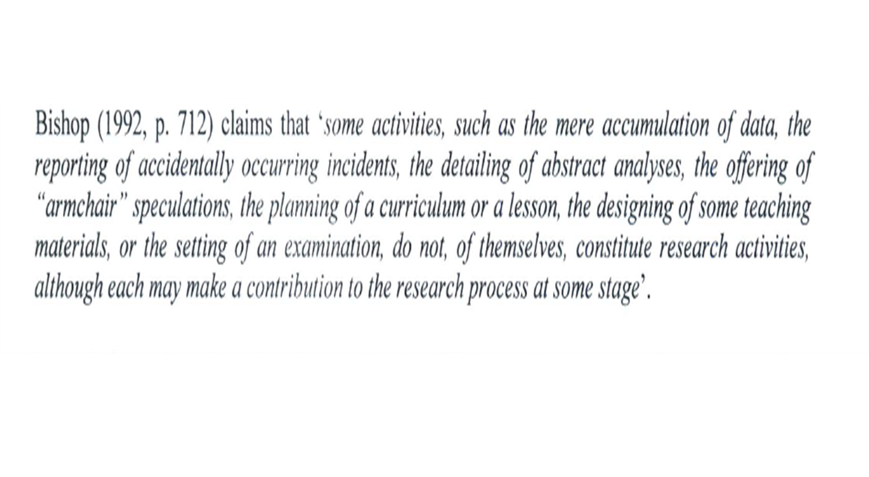
What are the characteristics of research in ME? (1)

Slide 6
What are the characteristics of research in ME? (2)
Zan (1999)
Research requires personal commitment
The choice of the problem of the theoretical framework, of the methodology, of the process of data analysis, of the interpretations involves the researchers’ decisional processes.
These decisional processes depend on the researcher’s epistemology, beliefs and values and need to become explicit.

Slide 7
What are the main changes in Research in Mathematics Education?
A new research domain (about 50 years, since 1960 the first research journals)
Research has involved significantly the last 30 years with the predominance of qualitative research methodologies
New theoretical perspectives and research methodologies
Major challenges with respect to standards for research quality
There is a dynamic and ongoing discussion of research quality versus a set of criteria and personal accounts about research

Slide 8
Theoretical perspectives and quality of research in ME
(Killpatric, 1992)
Positivistic (behavioristic) view
teaching and learning as a system of interacting variables
Interpretivist view
Meaning that the teaching and learning of mathematics have for the participants by living in a classroom
Critical view
Change the environment
Quantitative/qualitative – analytical/ systemic approach – precision/authenticity

Slide 9
Challenges about defining criteria
The difference between quality of a study and quality of a report
Can we talk about the same criteria for the different research paradigms?
Are the criteria relevant to the current research in the field?
Are the criteria shared by all researchers in the field?
Are the criteria refer to specific parts of the research or to the research as a whole?

Slide 10
Killpatrick’s criteria (1)
Relevance
What is the use of it?
For whom? (eg. to teachers? To researches?)
Basic versus applied research (the link between research and practice)
Quality – relevance and usefulness are bound togethter

Slide 11
Killpatrick’s criteria (2)
Validity
Has our research method allowed us to investigate what we intended to investigate?
What is it that we have studied? What is the case of?
What are the consequences of the research?

Slide 12
Killpatrick’s criteria (3)
Objectivity
Different opposing opinions
Researchers need to reflect on their own biases and provide evidence on their role in their study
Researchers need to refute their own conclusions to strengthen their argument.

Slide 13
Killpatrick’s criteria (4)
Originality
Relative and not absolute
Old things with a new light
It does not mean a lack of connection to prior research

Slide 14
Killpatrick’s criteria (5)
Rigor and Precision
Rigor versus relevance
Negative and positive sides (rigidity, inflexibility, procedural; accuracy)
Moving from the precision of measurement to the precision of meaning
“Care taken in observation, the attention to detail, the willingness to test alternatives than from fidelity to any standard procedure” (p. 27)

Slide 15
Killpatrick’s criteria (6)
Predictability
Eg. predict how students or teachers will respond to a task
Patterns of regularity
Traditionally a cause-effect relation
Prediction is not possible in a classroom (not a closed system)
How well the inferences made from the literature review and the theory allow us to anticipate what will happen in a particular phenomenon

Slide 16
Killpatrick’s criteria (7)
Reproducibility
Research procedure, observations, patterns of results clearly stated to be reproduced
Make the research public
Reproducibility is related to generalisation

Slide 17
Killpatrick’s criteria (8)
Relatedness
Both to mathematics and to the educational process
What about studies that mathematics is only a placeholder?
The interdisciplinary character of research in Mathematics Education (try theories from other research domains)

Slide 18
Why do we need criteria?
To assess our own work and the work of others
The offer us lenses through which the research landscape can be viewed.

Slide 19
Task1: What are the criteria of the international research journals of the quality of Research (1)
Educational Studies in Mathematics is an international journal of research and scholarship in mathematics education. It aims to illuminate issues of principle, policy and practice in the field and to promote the development of coherent bodies of theorized knowledge which can be brought to bear on these issues.
The journal seeks to publish original articles which address the aims set out above, make a significant contribution to the field, and are interesting and accessible to a diverse international readership.
Many different forms of research and scholarship can contribute to the aims of the journal, and that these will draw on differing perspectives and approaches.

Slide 20
Task1: What are the criteria of the international research journals of the quality of Research (2)
A submission should make explicit the theoretical and methodological framework within which this evidence has been gathered and analysed. A submission should show critical awareness of other possible approaches.
The submission will be evaluated in terms of appropriate criteria of rigour, intended to ensure that the analysis is well-founded, that it develops a cogent argument, and that it takes account of other relevant research and scholarship in the field.

Slide 21
Task1: What are the criteria of the international research journals of the quality of Research (3)
Journal for research in mathematics education
Criteria: Worthwhileness , Coherence, competence, openness, ethics, credibility, other qualities (clarity – originality)
Wothwhileness has to do with the potential of a research study for adding to and deepening our understanding of issues associated with mathematics teaching and learning

Slide 22
Task1: What are the criteria of the international research journals of the quality of Research (4)
Coherence. Thoughtful researchers first give serious attention to identifying interesting and worthwhile research questions and then to selecting the research methods and techniques that best fit the nature of those questions.
Competence. The study it must include the effective application of appropriate data collection, analysis and interpretation techniques.
Credibility. The claims made and conclusions drawn should be justified in some acceptable way.

Slide 23
Task1: What are the criteria of the international research journals of the quality of Research (5)
Openess. A) Good researchers are cognizant of the personal biases and assumptions that underlie their inquiry
b) the conceptual/theoretical bases for a study and the research methods and techniques used should be described in sufficient detail to allow the research community to scrutinize them thoroughly.
Originality. An original study is not a necessarily one that has never been done before. Rather, originality can also result from looking at an old question in a novel manner, using a new technique of analysis, synthesizing evidence in a different way, or providing a new interpretation for old data.

Slide 24
The role of the researchers’ epistemological choices
There is not agreement among the researchers about the criteria
Problem- led perspective versus method-led perspective
In the first we have multiplicity of methods to access the problem. The method is related to the problem
in the second, quality criteria are linked to the method used (eg sociological, anthropological, ethnographical research)
Design research versus phenomenological research

Slide 25
An example to illustrate epistemological differences
The relation between relevance and utility
Research on teachers’ decisions and the factors that frame them
The recognition of the teachers’ role is very important
Usefulness is not to use the research results immediately in the classroom but to influence teachers’ decision making.
The relation between theory and practice and the responsibility of the researcher.

Slide 26
A dynamic dimension of quality of research in mathematics education (ME)
Simon (2004)
“In mathematics education research, as in mathematics, there is a need to reflect on the state of the field, endeavor to make canons for quality explicit, and consider the process by which new researchers are acculturated into the field”

Slide 27
Issues of research quality (1)
An empirical research study as an argument:
Justification of the research questions (importance in relation to what is known)
Justification of the methodology
Justification of the analysis of data (make clear the chain of reasoning that lead to interpretations – present a part of the data- convince the communtity that data analyzed were central to the problems)
Justification of conclusions (contribution to knowledge linking to other research)

Slide 28
Issues of research quality (2)
Theoretical Research as an argument (based on prior empirical and theoretical work)
Description is generally not enough
Researcher’s responsibility to frame his or her case as a paradigm case, articulating what is a case of and explicating conclusions
When is empirical work at a level for publication?
It makes a contribution to knowledge
It warrants for the claims to be strong

Slide 29
Issues of research quality (3)
Rigorous application of methodologies is not sufficient
Methodology must respond to the different purposes and contexts of research
Analysing qualitative data is much like solving a mathematics problem – each step leads to greater insight as to what might be tried subsequently
Research questions evolve

Slide 30
Issues of research quality (4)
What are we looking for? – An epistemologically based question
“ what is” versus “developing an empirically based construct fo account for interesting aspects of the data”
Building on the work of others to
show the importance of your research questions
Relate the new contributions to existing knowledge

Slide 31
Researching Research: the role of theories in research and practice (1)
Lerman, Xu and Tsatsaroni (2003) ( need to consider the social dimension)
(Pais and Valero (2012) (need to consider the political dimension)
The theoretical and analytical lenses we deploy in the research underlie ideological motivations and trends of which we are not aware.
What is the object of research in mathematics education reported in journals, books, conference proceedings?
Issues of relevance of research and a broadening perception of the specificity of mathematics; research that addresses social, cultural, political dimensions

Slide 32
Researching Research: the role of theories in research and practice (2)
Bergsten (2007) investigates the role of theory through comparing three studies that all investigate learning and teaching the limit of functions
“A research framework defines the world in which the research live, pointing to difficulties to compare research results within different frameworks” (p. 1638)
This paper poses different issues about the important role of theory in research in terms of the research questions, the methodological choices, the interpretations and the nature of findings. How these different parts of a research are linked (consistency and coherency) is related to the quality of research.

Slide 33
Typical format of a research report (1)
Abstract: What was done and found
summarise the research aim, its design, and the main results.
Introduction: What is the problem?
the area of concern (setting the scene);
the problem (usually stated as a research question); and
the significance of the problem (the theoretical and/or practical reasons for exploring the research questions

Slide 34
Typical format of a research report (2)
Literature review: What is already known?
Theoretical framework
theories related to the research study
It frames the design, the entire discussion and provides explanatory power for the data
the lens that you use to interpret what is happening and why
A synthesis of literature review
Summarize the studies that are related you your research goal.
What common threads hold these studies together?
What does your study come to contribute (possible gaps)

Slide 35
Typical format of a research report (3)
Methodology: How was the research undertaken?
Why were your methods of data collection and analysis used? (collection versus generation/construction)
How do they fit with the theoretical framework outlined above?
Provide information about participants, the context of the study, the process of data collection (research instruments) and the process of data analyis

Slide 36
Typical format of a research report (4)
Results and discussion: What was found?
Results and discussion separate or integrated
summarize the evidence that was collected and analyzed in terms of your research questions
interpret these data
draw hint at some conclusions (relate to relevant research)
Conclusion: So what?
Summarise your research findings
Discuss consequences, implications, limitations.
Claims follow logically from results section.

Slide 37
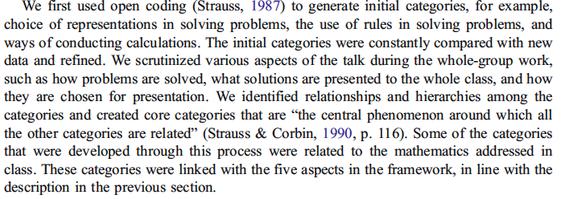
Example of the methodological part of a paper: data analysis (1)

Slide 38
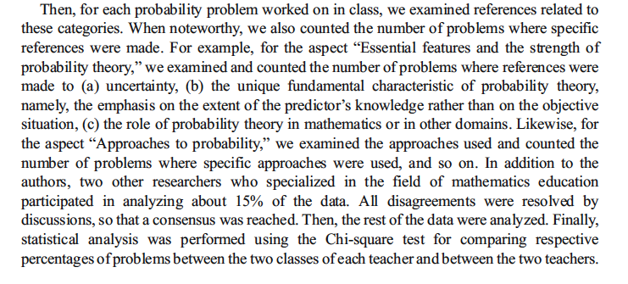
Example of the methodological part of a paper: data analysis (2)

Slide 39
Task 2: Analyzing reviews
You have been given a review of a researcher for a paper submitted in an international journal.
Work in groups of 4 persons for 15 minutes to highlight how the researcher sees the quality of the research in his review (in general and more specifically in terms of the particular parts of the paper (literature review, research goals/questions, methodology, results, conclusions).
Summarize your group observations so that one member of the group to present them for 2 minutes in the class.

Slide 40
Questions addressed
What are the emerging issues in relation to the quality of the study in each review?
Are there differences in relation to the different theoretical perspectives (qualitative – quantitative, psychological- sociocultural-social-sociopolitical)?

Slide 41
Task 3: Evaluating a proposal for a short-oral presentation
Work in groups of 4 persons. Read the short oral and identify
the research goal and the research questions
The theoretical concepts that frame the study
The methodological part
The main findings
Discuss in your group if you judge that this study
Addresses an important question
It offers justified arguments in A,B,C and D
The way that A, B, C, D link
What you think that it should change
(15 minutes)
Prepare a short presentation to report in the class (2 minutes)

Slide 42
Reflections
If you would like to design a research state 3 things that would be the most important to consider?

Slide 43
References
Bergsten, Ch. (2007). How do theories influence the research on teaching and learning limits of functions? Working group 11, CERME 5, Larnaca, Cyprus.
Killpatric, J. (1993). Beyond Face value: Assessing Research in mathematics education. In G. Nissen & M. Blomboj (eds. ), Criteria for scientific quality and relevance in the didactics of mathematics (pp. 15-34). Roskilde: Danish Research Council for the Humanities.
Lerman, S., Xu, G and Tsatsaroni (2003). Developing theories of mathematics education research: The ESM story, Educational Studies in Mathematics, 51, 23-40.
Mousley, J. Some advice about writing MERGA articles. http://www.merga.net.au//sites/default/files/editor/documents/. Giving %20papers%20a%20chance.doc
Pais, A. & Valero, P. (2012). Researching Research: Mathematics Education in the Political. Educational Studies in Mathematics, 80, 9-24.
Simon, M. (2004). Raising Issues of Quality in Mathematics Education Research, Journal for Research in Mathematics Education, 35, 157-163.
Zan, R. (1999). The quality of Research in Mathematics Education, Paper presented in the Plenary Panel on “Quality of Research in Mathematics Education”, Santarem, Spain.

Slide 44
Τέλος Υποενότητας
Quality of research in Mathematics Education

Slide 45
Χρηματοδότηση
Το παρόν εκπαιδευτικό υλικό έχει αναπτυχθεί στo πλαίσιo του εκπαιδευτικού έργου του διδάσκοντα.
Το έργο «Ανοικτά Ακαδημαϊκά Μαθήματα στο Πανεπιστήμιο Αθηνών» έχει χρηματοδοτήσει μόνο την αναδιαμόρφωση του εκπαιδευτικού υλικού.
Το έργο υλοποιείται στο πλαίσιο του Επιχειρησιακού Προγράμματος «Εκπαίδευση και Δια Βίου Μάθηση» και συγχρηματοδοτείται από την Ευρωπαϊκή Ένωση (Ευρωπαϊκό Κοινωνικό Ταμείο) και από εθνικούς πόρους.

Slide 46
Σημειώματα

Slide 47
Σημείωμα Ιστορικού Εκδόσεων Έργου
Το παρόν έργο αποτελεί την έκδοση 1.0.

Slide 48
Σημείωμα Αναφοράς
Copyright Εθνικόν και Καποδιστριακόν Πανεπιστήμιον Αθηνών, Πόταρη Δέσποινα, Σακονίδης Χαράλαμπος. «Ποιοτική μεθοδολογία έρευνας στη Διδακτική των Μαθηματικών, Η εξέλιξη της έρευνας και η πρόσφατη στροφή». Έκδοση: 1.0. Αθήνα 2015. Διαθέσιμο από τη δικτυακή διεύθυνση: http://opencourses.uoa.gr/courses/MATH17/.

Slide 49
Σημείωμα Αδειοδότησης
Το παρόν υλικό διατίθεται με τους όρους της άδειας χρήσης Creative Commons Αναφορά, Μη Εμπορική Χρήση Παρόμοια Διανομή 4.0 [1] ή μεταγενέστερη, Διεθνής Έκδοση. Εξαιρούνται τα αυτοτελή έργα τρίτων π.χ. φωτογραφίες, διαγράμματα κ.λ.π., τα οποία εμπεριέχονται σε αυτό και τα οποία αναφέρονται μαζί με τους όρους χρήσης τους στο «Σημείωμα Χρήσης Έργων Τρίτων».
[1] http://creativecommons.org/licenses/by-nc-sa/4.0/
Ως Μη Εμπορική ορίζεται η χρήση:
που δεν περιλαμβάνει άμεσο ή έμμεσο οικονομικό όφελος από την χρήση του έργου, για το διανομέα του έργου και αδειοδόχο
που δεν περιλαμβάνει οικονομική συναλλαγή ως προϋπόθεση για τη χρήση ή πρόσβαση στο έργο
που δεν προσπορίζει στο διανομέα του έργου και αδειοδόχο έμμεσο οικονομικό όφελος (π.χ. διαφημίσεις) από την προβολή του έργου σε διαδικτυακό τόπο
Ο δικαιούχος μπορεί να παρέχει στον αδειοδόχο ξεχωριστή άδεια να χρησιμοποιεί το έργο για εμπορική χρήση, εφόσον αυτό του ζητηθεί.

Slide 50
Διατήρηση Σημειωμάτων
Οποιαδήποτε αναπαραγωγή ή διασκευή του υλικού θα πρέπει να συμπεριλαμβάνει:
το Σημείωμα Αναφοράς
το Σημείωμα Αδειοδότησης
τη δήλωση Διατήρησης Σημειωμάτων
το Σημείωμα Χρήσης Έργων Τρίτων (εφόσον υπάρχει)
μαζί με τους συνοδευόμενους υπερσυνδέσμους.

Slide 51
Σημείωμα Χρήσης Έργων Τρίτων
Το Έργο αυτό κάνει χρήση των ακόλουθων έργων:
Εικόνες/Σχήματα/Διαγράμματα/Φωτογραφίες

