Slide 1
Empirische Sprachforschung
User Interface Design for the interactive use
of Online Spoken German Journalistic Texts for the International Public
Dr. Christina Alexandris
Nationale Universität Athen
Deutsche Sprache und Literatur

Slide 2
1. User Requirements and Error Data
The present approach concerns a set of specifications for an annotation module and its user-interface for the interactive use of online spoken German journalistic texts.
The proposed design targets to provide the in-context indication of ambiguous or connotative linguistic and paralinguistic information to non-native speakers of the German language, in particular, students, translators and journalists.
The boundaries of possible differentiations in respect to the semantics of expressions become less evident in spoken journalistic texts, where they are highly context-dependent and determined by their usage in the language community.

Slide 3
For the successful implementation of the proposed module
a detailed approach to User Requirements is necessary [3], [8].
The target user-group usually has an above-average or even a fairly good fluency of a foreign language such as German or more than one foreign languages,
but are either non-native speakers and/or often lack the necessary exposure to the culture related to the foreign language concerned, especially if the place of work/ correspondence changes frequently.
Thus essential information in on-line texts presented either in a subtle form or in an indirect way (“explicitation”, [4]), such as text-in-context relationships and socio-textual practices is often undetected.

Slide 4
The international public
is generally interested to be able to have an insight in respect to a specific issue or event from a not always explicitly expressed insider’s or an outsider’s point of view or from an international perspective.
Furthermore, the international public often has to make choices in respect to what types of online spoken/written journalistic texts to use for professional purposes and what types of online spoken/written journalistic texts to omit and/or discard.
This decision-making process may be time-consuming, since the User is required to read or hear the text many times.

Slide 5
Typical indicators of connotative features
such as fixed expressions and idioms do not occur often enough in texts to signalize a point of view or attitude conveyed
and many paralinguistic elements may be absent in some multimedia files, for instance in a cases where the speaker (for, example, a correspondent) is not visible.
Furthermore, in languages such as Standard German, it is observed that speakers do not always demonstrate obvious changes in prosody when making subtle ironic statements, changes not easily detected by an international audience.
Additionally, paralinguistic elements expressing speakers’ or journalists’ attitude may be misinterpreted or overlooked by an international audience, unless extreme emotions are expressed.

Slide 6
The proposed specifications and related annotation module
is language-specific and its basic parameters are designed based on translational error-types retrieved from empirical data concerning the language pairs English, German and Greek.
Most data involves mistranslations of spoken and written journalistic texts (data provided from graduate courses for professional translators), as well as failure to correctly interpret paralinguistic elements in online multimedia journalistic files by transcribers and professional journalists.

Slide 7
The data
was collected from graduate courses for journalists (M.A in Quality Journalism and Digital Technologies, Danube University at Krems, Athena- Research and Innovation Center in Information, Communication and Knowledge Technologies, Athens, Institution of Promotion of Journalism Ath.Vas. Botsi, Athens)
and from data transcribed from spoken journalistic texts in European Union projects, especially the CIMWOS Project [9].

Slide 8
2. Combination with Transcription Tools and User Interface
The online transcribed spoken journalistic texts are scanned by the proposed morphologically-based module and the User is presented with an output in the module’s user-interface constituting the actual text with an in-context indication of all the instances of
(a) ambiguous or
(b) connotative linguistic information and
(c) language and culture-specific paralinguistic features, which are signalized in different categories, based on error data obtained from the above-mentioned sources [9].
These signalizations are the most commonly occurring types of such information observed in spoken German journalistic texts, namely (1) “Stress”, (2) “Casual” and (3) “Non-neutral”
and indicate elements stressed by the speaker (1), a casual tone (2) or connotative features (3) respectively.

Slide 9
The module is designed to be able to be compatible with most commercial transcription tools,
some of which are available online [10], [11] (Figure 1).
Specifically, the module operates on keyword detection at morpheme-level or word-level based on interaction with a simple database which is, however, constructed on ontological principles, and may be visible and extended by the User.
The database concerns a restricted set of word stems and suffixes as well as a defined set of verb stems that may be enriched.
Incoming text may also be downloaded written journalistic texts from the internet such as blogs.

Slide 10
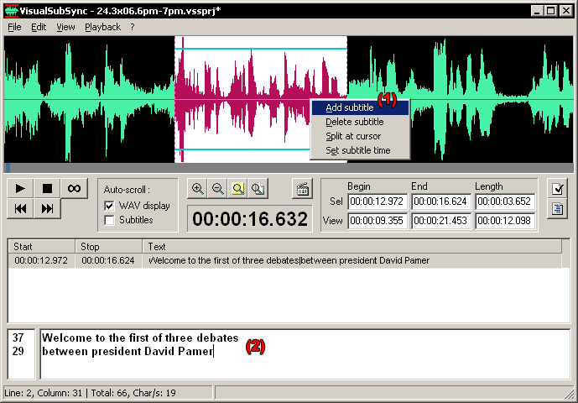
Examples of commercial transcription tools available online. www.visualsubsync.org
Εικόνα 1: How to create subtitles and captions for videos

Slide 11
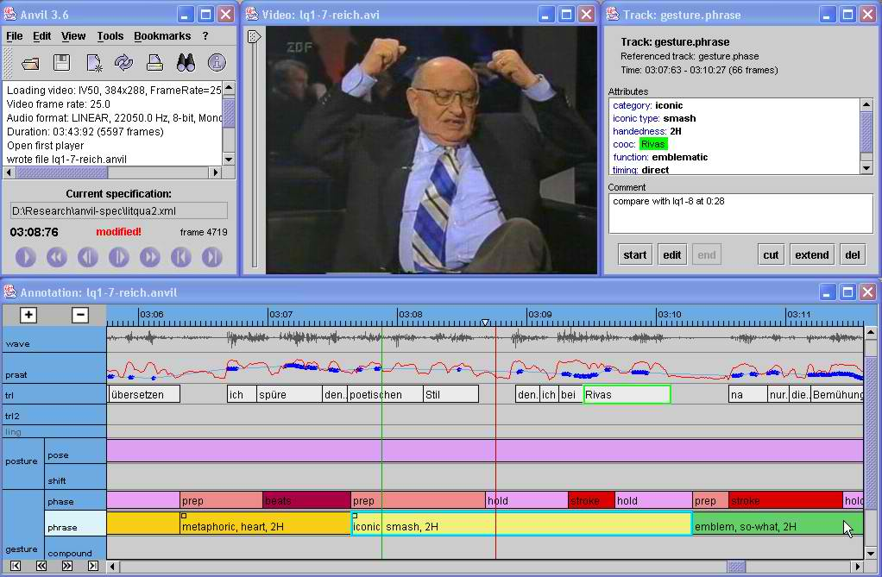
Examples of commercial transcription tools available online. http://www.anvil-software.de/
Εικόνα 2: Anvil Software transcription tool

Slide 12
2.1 User Interaction and User Interface
The proposed module combines spoken words with paralinguistic elements, which are sometimes existent, such as in the case of prosodic emphasis, or sometimes they are non-existent or too subtle to be detected by non-native speakers.
The combination of words with paralinguistic elements allows
(a) a better understanding of the connotative elements in spoken texts and
(b) may additionally also be used for research and development purposes in respect to mapping of spoken word and prosody and/or gesture.

Slide 13
During the transcription
written words belonging to the categories “STRESS”, “CASUAL” and “NON-NEUTRAL” described in Section 3 are automatically highlighted.
Sections with higher amplitude corresponding to prosodic emphasis are automatically selected and signalized, either from the automatically generated pitch contours provided by many available transcription systems or only as signalized peaks in amplitude in the simpler systems.
The possibility of gestures, often occurring along with such words and prosodic emphasis, is retrieved in the respective temporal points in the wav file by the User.

Slide 14
User interaction may be described in three steps
which correspond to three respective levels in the annotation module appended to the transcription tool employed by the User.
In the first step, the User listens to the recorded speech and/or video and adds the respective text to the speech signal, a standard process for most transcription tools.
When specific word types are written corresponding to possible connotative features, the proposed additional module highlights these word types in a respective color determined by the User (1).
In the second step, the recorded speech and/or video can be replayed by the User. The points containing the previously highlighted words are compared to the speech signal and the respective tag, according to the amplitude of the speech signal, is produced namely “STRESS”, “CASUAL” and “NON-NEUTRAL”(2).
As an optional third step, the proposed annotation module allows the User to append additional comments, especially in respect to paralinguistic features not related to the speech signal (facial expressions, gestures) (3).

Slide 15
3. Database: Combination of Word Categories with Paralinguistic Features
Words related to the tag “STRESS” for Spoken German are all word categories combined with prosodic stress, signalizing what the speaker considers important to underline and are detectable with a rise in amplitude in speech signal.
The stressed words are of additional importance if they also coincide with the “NON-NEUTRAL” category described here.
In less formal contexts, a casual and/or friendly or communicative attitude related to the tag “CASUAL” is signalized by specific sets of particles, adverbials and exclamations that are, however, not accompanied by prosodic stress.
Typical examples are the expressions “doch”, “eben”, “gleich”, “doch bitte“ [1], [2]. In order to be classified as “CASUAL“ elements, such words selected in text level should be accompanied by lack of prosodic emphasis, otherwise, they are marked as “STRESS“ words.

Slide 16
The detection of specific sets of words
is used in regard to the detection of “NON-NEUTRAL” elements.
These words are often combined with paralinguistic elements. However, these features are not always present or not easily detectable by the international public.
The detection of these words is based on the flouting of the Gricean Cooperativity Principle, especially in regard to the violation of the Maxims of Quality and Quantity [2], [6], [7].

Slide 17
Specifically, the strategy concerns morphological processing
operating on (A) a word-stem basis [2] involving the detection of
(1) adjectives and adverbials, containing semantic features related to (i) descriptive features (ii) mode (iii) malignant/benign action or (iv) emotional/ethical gravity,
(2) verb-stems from verbs containing semantic features (including implied connotations in language use) related to (i) mode (ii) malignant/benign action or (iii) emotional/ethical gravity[2].
These verb stems are located low in an ontology, approachable with Selectional Restrictions [5] of the modifying type (and/or Wordnets).

Slide 18
Morphological processing
also operates on (B) a suffix basis involving the detection of
(2) suffixes producing diminutives and
(3) a predefined set of derivational suffixes resulting to a nominalization of verbs (derivational suffixes producing participles and actor thematic roles are excluded) or a verbalization or adjectivization of proper nouns.
Thus, a specified and finite set of "marked" suffixes (such as, “-erei”) is defined, as well as a defined group of "marked" verb-stems, such as “schuften” (partially equivalent to “to slave away”).

Slide 19
Examples
Typical examples of the “NON-NEUTRAL” category occurring in the on-line spoken texts are the expressions
“(ein) schoenes (Wahlversprechen)” (“that’s some (ironic: great) pre-election promise) and
“zurueckegerudert” (= to row back, used instead of the expression “to go back”)
(Speaker: Correspondent (Male), Spiegel Online, CDU/CSU-Wahlprogramm: Wer glaubt an Steuergeschenke? 29.06.2009).

Slide 20
Table 1. Levels of proposed annotation module and transcription tool
AVAILABLE TRANSCRIPTION TOOL: Speech Signal and/or Video & Transcribed Text and annotation scheme /respective levels provided by tool
MODULE : LEVEL 1: Automatic word spotting and highlighting & combination with speech signal and/or video in time
LEVEL 2: Mapping of highlighted words with speech signal and/or video in time & respective tag : “STRESS”, “CASUAL”, “NON-NEUTRAL”
LEVEL 3: (Optional) Template for additional comments by User (comparison with other paralinguistic elements)

Slide 21
4. Conclusions and Further Research
The present approach intends to capture the three most commonly occurring categories of lexical information related to paralinguistic information constituting connotative features in spoken German journalistic texts.
For the international audience, the elements selected by the module can be “safer” pointers to the intentions and/or spirit of the speaker than most culture-specific paralinguistic elements related only to prosody and gesture.
Further research in spoken German journalistic texts may provide more categories of connotative information not easily detectable to the international public.
Implementation of the proposed annotation module to various user groups such as professionals and/or students will provide evaluation results for further development.

Slide 22
References 1/2
Alexandris, C.: Speech Acts and Prosodic Modeling in Service-Oriented Dialog Systems. In: Computer Science Research and Technology. Nova Science Publishers, Hauppauge, New York, NY, (2010)
Alexandris, C: English, German and the International “Semi-professional” Translator: A Morphological Approach to Implied Connotative Features. In: Journal of Language and Translation, September 2010,Vol 11, Number 2, pp 7-46 Sejong University, Korea (2010)
Constantie L.L., Lockwood, L.A.D.: Software for Use: A Practical Guide to the Models and Methods of Usage-Centered Design. Addison-Wesley, Reading, MA: Addison-Wesley (1996)
De Silva, R.: Explicitation in Media Translation: English Translation of Japanese Journalistic Texts. In: Proceedings of the 1st Portuguese Translation Conference, Caparica, Portugal, (2006)
Gayral, F., Pernelle, N., Saint-Dizier, P.: On Verb Selectional Restrictions: Advantages and Limitations. In: Christodoulakis, D.N. (ed.): Lecture Notes in Artificial Intelligence, Nr. 1835, pp 57-68. Springer, Berlin (2000) .

Slide 23
References 2/2
Grice, H.P.: Studies in the Way of Words. Harvard University Press, Cambridge, MA (1989)
Hatim, B. (1997): Communication Across Cultures: Translation Theory and Contrastive Text Linguistics. University of Exeter Press, Exeter (1997)
Wiegers, K. .E.: Software Requirements. Microsoft Press, Redmond, WA (2005)
The CIMWOS Project www.xanthi.ilsp.gr/cimwos/
Visualsubsync Subtitling tool: www.visualsubsync.org
Anvil Software transcription tool: http://www.anvil-software.de/

Slide 24
Τέλος Ενότητας

Slide 25
Χρηματοδότηση
Το παρόν εκπαιδευτικό υλικό έχει αναπτυχθεί στo πλαίσιo του εκπαιδευτικού έργου του διδάσκοντα.
Το έργο «Ανοικτά Ακαδημαϊκά Μαθήματα στο Πανεπιστήμιο Αθηνών» έχει χρηματοδοτήσει μόνο την αναδιαμόρφωση του εκπαιδευτικού υλικού.
Το έργο υλοποιείται στο πλαίσιο του Επιχειρησιακού Προγράμματος «Εκπαίδευση και Δια Βίου Μάθηση» και συγχρηματοδοτείται από την Ευρωπαϊκή Ένωση (Ευρωπαϊκό Κοινωνικό Ταμείο) και από εθνικούς πόρους.

Slide 26
Σημειώματα

Slide 27
Σημείωμα Ιστορικού Εκδόσεων Έργου
Το παρόν έργο αποτελεί την έκδοση 1.0.

Slide 28
Σημείωμα Αναφοράς
Copyright Εθνικόν και Καποδιστριακόν Πανεπιστήμιον Αθηνών, Χριστίνα Αλεξανδρή. «Εμπειρική Γλωσσολογική Έρευνα, User Interface Design for the interactive use of Online Spoken German Journalistic Texts for the International Public ». Έκδοση: 1.0. Αθήνα 2015. Διαθέσιμο από τη δικτυακή διεύθυνση:
http://eclass.uoa.gr/courses/GS208/

Slide 29
Σημείωμα Αδειοδότησης
Το παρόν υλικό διατίθεται με τους όρους της άδειας χρήσης Creative Commons Αναφορά, Μη Εμπορική Χρήση Παρόμοια Διανομή 4.0 [1] ή μεταγενέστερη, Διεθνής Έκδοση. Εξαιρούνται τα αυτοτελή έργα τρίτων π.χ. φωτογραφίες, διαγράμματα κ.λ.π., τα οποία εμπεριέχονται σε αυτό και τα οποία αναφέρονται μαζί με τους όρους χρήσης τους στο «Σημείωμα Χρήσης Έργων Τρίτων».
[1] http://creativecommons.org/licenses/by-nc-sa/4.0/
Ως Μη Εμπορική ορίζεται η χρήση:
που δεν περιλαμβάνει άμεσο ή έμμεσο οικονομικό όφελος από την χρήση του έργου, για το διανομέα του έργου και αδειοδόχο
που δεν περιλαμβάνει οικονομική συναλλαγή ως προϋπόθεση για τη χρήση ή πρόσβαση στο έργο
που δεν προσπορίζει στο διανομέα του έργου και αδειοδόχο έμμεσο οικονομικό όφελος (π.χ. διαφημίσεις) από την προβολή του έργου σε διαδικτυακό τόπο
Ο δικαιούχος μπορεί να παρέχει στον αδειοδόχο ξεχωριστή άδεια να χρησιμοποιεί το έργο για εμπορική χρήση, εφόσον αυτό του ζητηθεί.

Slide 30
Διατήρηση Σημειωμάτων
Οποιαδήποτε αναπαραγωγή ή διασκευή του υλικού θα πρέπει να συμπεριλαμβάνει:
το Σημείωμα Αναφοράς
το Σημείωμα Αδειοδότησης
τη δήλωση Διατήρησης Σημειωμάτων
το Σημείωμα Χρήσης Έργων Τρίτων (εφόσον υπάρχει)
μαζί με τους συνοδευόμενους υπερσυνδέσμους.

Slide 31
Σημείωμα Χρήσης Έργων Τρίτων (1/2)
Το Έργο αυτό κάνει χρήση των ακόλουθων έργων:
Εικόνες/Σχήματα/Διαγράμματα/Φωτογραφίες
Εικόνα 1: How to create subtitles and captions for videos, VisualSubSync, The subtitle program / subtitle editor, http://www.visualsubsync.org/tutorials/making-transcript, http://www.visualsubsync.org/_media/tutorials/t01_03_maindialog.png, tutorials/making-transcript.txt · Last modified: 2009/07/14 by viswhat, date accessed: 03.09.15
Εικόνα 2: Anvil Software transcription tool: http://www.anvil-software.de/, date accessed: 13.09.2015

Slide 32
Σημείωμα Χρήσης Έργων Τρίτων (2/2)
Το Έργο αυτό κάνει χρήση των ακόλουθων έργων:
Πίνακες

