Slide 1
Empirische Sprachforschung
Information Management in the Media
PARALINGUISTIC FEATURES
IN SPOKEN JOURNALISTIC TEXTS
Dr. Christina Alexandris
Nationale Universität Athen
Deutsche Sprache und Literatur

Slide 2
Information Management in the Media
PARALINGUISTIC FEATURES IN SPOKEN JOURNALISTIC TEXTS
[short and modified version for undergraduate students]

Slide 3
Informationssteuerung in den Medien: Beziehung zwischen Faktoren und Text
MEDIEN-KATEGORIE
ZIEL ANSICHT/STANDPUNKT
PUBLIKUM
INHALT/STRUKTUR
MACHT
SOCIOLING. MERKMALE
PARALING. MERKMALE

Slide 4
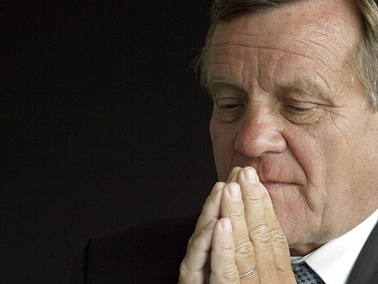
H. PARALINGUISTISCHE MERKMALE
Prosodie –Ton
Gestik –Bewegungen
Blickfeld –Zoom-in/Zoom-out der Kamera
Εικόνα 1:
Hartmut Mehdorn hat sich beim Bahn-Betriebsrat für die konzernweite Rasterfahndung entschuldigt. Die Gewerkschaften verlangen jedoch nach mehr. (sat-1)

Slide 5
G. SOZIOLINGUISTISCHE MERKMALE
Wortschatz
Wendungen
Metaphern
Vorausgesetztes Wissen (Assumed knowledge)

Slide 6
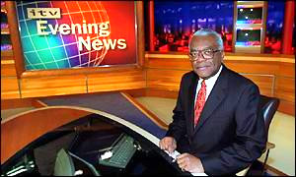
SHORT NEWS - HEADLINES
Εικόνα 2: Trevor McDonald: The face of ITN

Slide 7
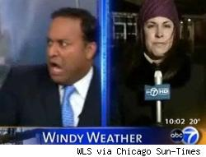
REPORT…..
Εικόνα 3: Car crashes into WLS studio

Slide 8
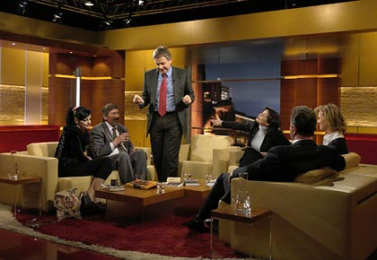
CONVERSATION
Εικόνα 4: Joachim Bublath

Slide 9
Relation of Media Type, Sociolinguistic Features and Paralinguistic Features in Spoken Journalistic Texts
A. MEDIA TYPE (MEDIEN-ART)
G. SOCIOLINGUISTIC FEATURES (SOZIOLINGUISTISCHE MERKMALE)
H. PARALINGUISTIC FEATURES
(PARALINGUISTISCHE MERKMALE)

Slide 10
Discourse Structure in Conversations (PRAGMATISCHE STRUKTUR DER DISKUSSIONEN)
Priority / Turn of Speakers
(VORRANG / REIHE/WECHSEL DER SPRECHER)
Protocol
No Protocol
Time per Speaker (ZEIT / SPRECHER)
Control of moderator / journalist
No control of moderator / journalist
Interruptions (UNTERBRECHUNGEN)
Control of moderator / journalist
No control of moderator / journalist
Mode / Style (ART UND WEISE/ STIL)
Language (SPRACHE)
Paralinguistic Elements (PARALINGUISTISCHE ELEMENTE)

Slide 11
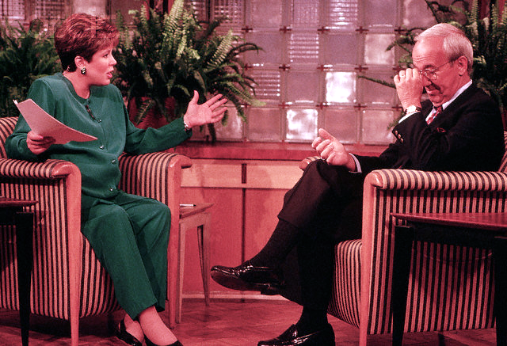
Discourse Structure -Speech Acts
Εικόνα 5: Anchorwoman Margaret Larsen appears on the 'Today Show' a week before her son is born, talking with one of the reporters for NBC News

Slide 12
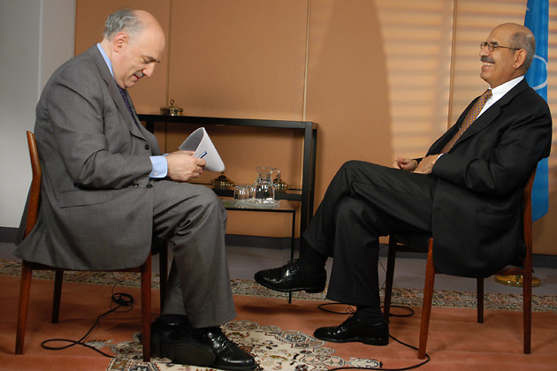
Discourse Structure -Speech Acts
Εικόνα 6: Mohamed ElBaradei shares a laugh with Tim Sebastian

Slide 13
Sources
GF004553| Value RM| © Annie Griffiths Belt/CORBIS
Margart Larsen and Reporter Anchorwoman Margaret Larsen appears on the "Today Show" a week before her son is born, talking with one of the reporters for NBC News. NBC's "Today Show" encourages anchorwomen, like Margaret Larsen, to work on camera throughout their pregnancies. Image: © Annie Griffiths Belt/CORBIS Collection: Documentary Value Value RM Photographer: Annie Griffiths Belt Date Photographed: August 1992 Location Information: Manhattan, New York, New York, USA
IAEA Director General Mohamed ElBaradei shares a laugh with Tim Sebastian, former BBC Hardtalk anchorman, before an interview. Vienna, Austria, 28 September 2004.

Slide 14
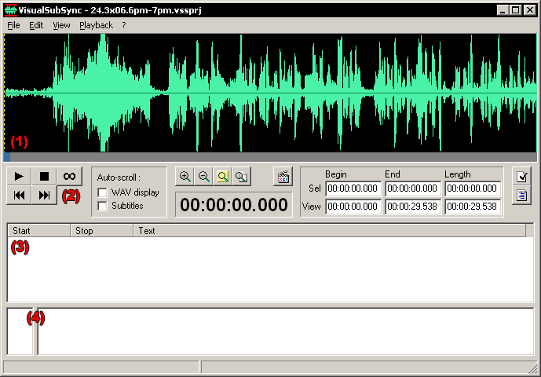
Example of a transcription tool: www.visualsubsync.org
Εικόνα 7: How to create subtitles and captions for videos

Slide 15
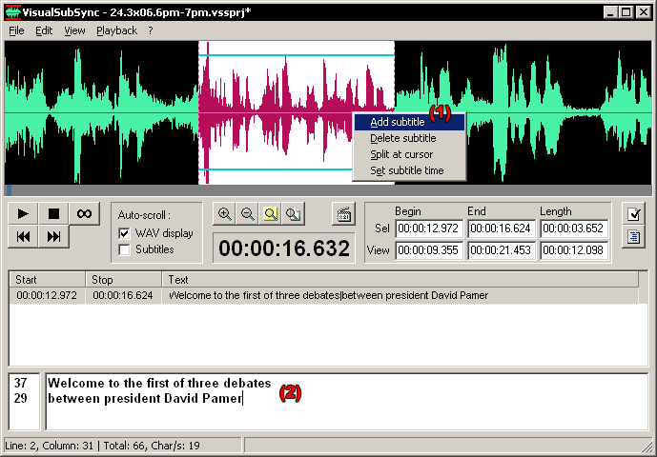
Adding subtitles
Εικόνα 8: Main dialog with the first subtitle

Slide 16
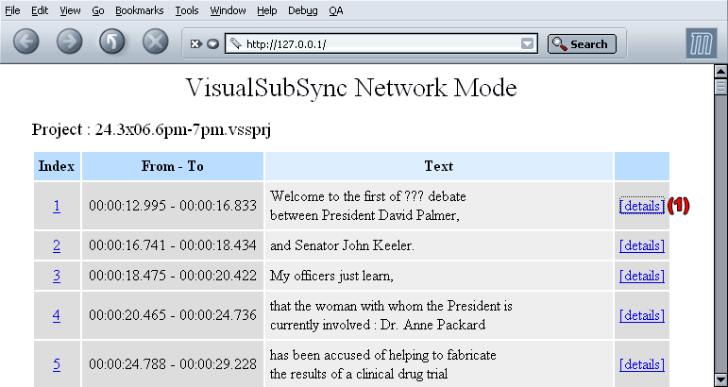
“special feature for people who's native language is different from the original video”
Εικόνα 9: Network mode

Slide 17
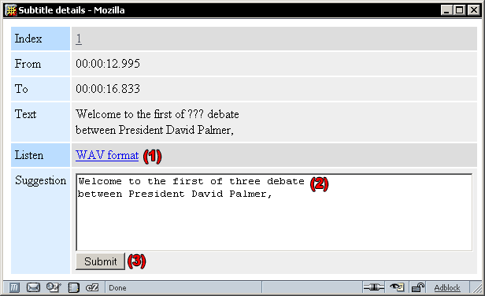
“special feature for people who's native language is different from the original video”
Εικόνα 10: Details page

Slide 18
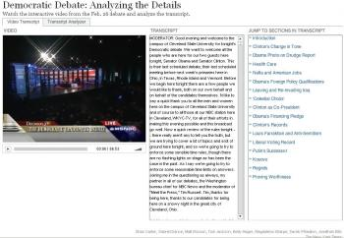
Released on Feb 26th, NY Times offers an interactive user interface for analyzing the most recent Democratic Debate: Video Transcript
Εικόνα 11: Democratic Debate: Video Transcript

Slide 19
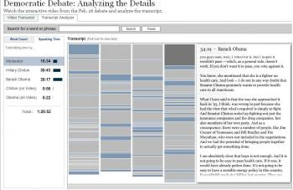
Transcript Analyzer:
Εικόνα 12: Democratic Debate: Analyzing the Details

Slide 20
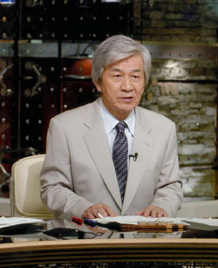
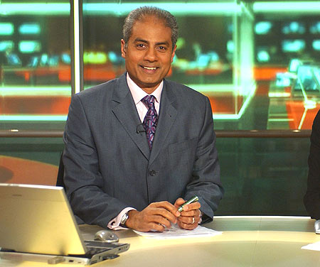
Speakers
Εικόνα 13: Chikushi Tetsuya, News anchorman, TBS Japan
Εικόνα 14: George Alagiah, George Alagiah, BBC newsreader

Slide 21
Speaker Categorization
The speakers of the transcribed and annotated spoken corpus are divided in two major categories, Trained Speakers (I) and Non-Trained Speakers (II).
The Trained Speakers category consists of three groups, namely Journalists, Politicians and Actors. The Journalist group, which constitutes the largest group of trained speakers, is divided into the ‘Anchormen’ and ‘Correspondents’ subgroups. The Actors group is the smallest group in the data.
The Non-Trained Speakers category consists of the subgroups Category 1 & 2.
Category 1 involves speakers who are not trained but clarity and consistency in their speech is required by their profession or by circumstances related to their profession. This subgroup consists mainly of officials in the public sector and scientists.
Category 2 involves all other non-trained speakers.
(Alexandris and Fotinea, 2004)

Slide 22
Formal Analysis of Speech Act Topic & Content
The discourse analysis of the corpus was performed manually. However, we used templates as a formal framework for the analysis and presentation of the topic and content of each speech act in the discourse framework of the corpus.
Each template corresponds to a specific speech act (“SPEECH-ACT”) which has a particular topic (“TOPIC”) or a set of topics.
Each topic has a specific content (“WHAT”) which may be one or more items (“WHAT-1”, “WHAT-2” etc.).
(Alexandris and Fotinea, 2004)

Slide 23
Figure 1: Speech Corpus example (Translation parallel to the Greek Text) (Alexandris and Fotinea, 2004)
ERT_20020510_1958_Net.trs, CIMWOS Project
SPEAKER[Minister Georgios Floridis] :
What we decided about recruitments is that [PAUSE] they will obey to two rules, first {of all} to the necessity [BREATH] of an [EH] effective operation of the [AH] government. And to offer better services to the citizens. And, second[Mispronounced] {of all}, that {all} these recruitements [PAUSE] should be [EH] according to the possibilities of the budget {in question}.

Slide 24
Figure 2: Analysis in respect to the Speech Acts (Alexandris and Fotinea, 2004)
ERT_20020510_1958_Net.trs, CIMWOS Project
SPEAKER[Minister Georgios Floridis] :
SPEECH-ACT: DECLARE
TOPIC: What we decided about recruitments is that
[PAUSE]
WHAT
they will obey to two rules, first {of all} to the necessity [BREATH] of an
WHAT-1
[EH] effective operation of the [AH] government. And to offer better services to the citizens. And, second[Mispronounced] {of all}, that {all} these recruitments
[PAUSE]
WHAT-2
should be [EH] according to the possibilities of the budget {in question}.

Slide 25
Classifying Extra-Linguistic Markers in the Spoken Corpus
We divided the extra-linguistic markers into three categories, according to their corresponding type of speech signal.
The first category of extra-linguistic markers (Type 1) consists of a pause before the word or phrases uttered by the speaker. The pause the speaker makes is transcribed as SKIP(PAUSE) or SKIP(OTHER), if there is background noise.
The second category (Type 2) involves the emphasis of the word or phrase where, among other prosodic characteristics, an increase of the volume intensity of the speaker’s voice is recorded.
The third category of extra-linguistic markers (Type 3) consists of the sounds “Ah”, “Eh” and “Ih”, transcribed as [AH], [EH] and [IH]. The “Ih” sound is typical of Modern Greek.
(Alexandris and Fotinea, 2004)

Slide 26
Classifying Extra-Linguistic Markers in the Spoken Corpus
The core of the semantic content of the sentence, defined by the previously described sublanguage of the spoken corpus is often emphasized by the speaker (Type 2) or preceded by a pause (Type 1).
An equally frequent phenomenon in the present spoken corpus are the sounds [AH], [EH] and [IH] (Type 3) preceding the core of the semantic content of the sentence. In spoken Greek, the sounds “Ah”, “Eh” and “Ih” are related to the hesitation of the speaker.
We, therefore, name the third category of extra-linguistic markers the ‘Hesitation’ category.
(Alexandris and Fotinea, 2004)

Slide 27
Type of Extra-Linguistic Markers in Respect to Speech Act and Speaker
From the analysis of the spoken corpus we observe that the type of extra-linguistic marker varies according to the speaker category and the speech act performed.
Specifically, we observe that all speakers used Hesitation-markers before key-information when performing a speech-act of Description and Hesitation-markers and /or a pause before key-information when performing a speech-act of Declaration and Expression.
Non-trained Speakers of Category 2 also used Emphasis to express their feelings. Emphasis was the only type of extra-linguistic marker used before key-information in Announcement speech-acts, exclusively performed by the Journalist Trained Speaker group (Figure 3).
(Alexandris and Fotinea, 2004)

Slide 28
Figure 3: Distribution of Type of Extra-Linguistic Markers (E: Emphasis, H: Hesitation, P: Pause) in Respect to Speech Act and Speaker Category (Alexandris and Fotinea, 2004)
Speech Act Speakers | Announce | Describe | Declare | Express
Journalist Anchor | E | - | - | -
Journalist Correspondent | E | H | - | -
Politician | - | - | P H | -
Non-trained Speakers Category 1 | - | H | P H | H P
Non-trained Speakers Category 2 | - | H | - | H E

Slide 29
GENDER
Discourse Structure
Phonology-Prosody
Vocabulary
Paralinguistic Elements

Slide 30
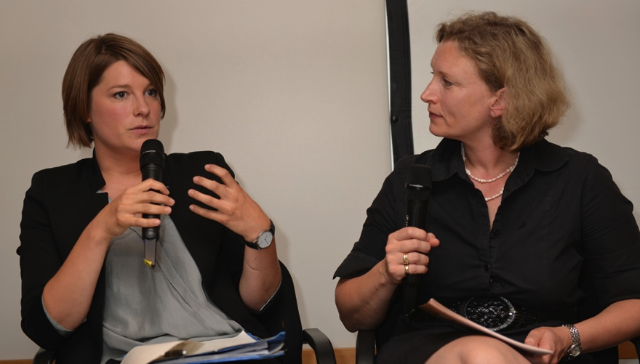
Women Journalists
Εικόνα 15

Slide 31
Gender- Gender in Doctor-Patient Dialogues [Forrester (1996)].
(West 1990, p. 91)
(example 1) – male doctor
(1) Patient: So, if I fe-ee:l this coming on, an’ I’m sidding up in a pla:ne, r’ I;m out
(2) somewhere in a car., h’n I can’t lie dow-
(3) Doctor: LIE DOW:N
(example 2) – female doctor
(1) Patient: I’m trying’ tuh (0.2) sid o::n this tailbone duh tyr and get it bedder
(2) an eviry chance I could try duh
(3) Doctor: oh:: don’ even try….if it hurts when yuh sid on it, stay
(4) off of it

Slide 32
Discourse – Pragmatics
“Women, to a greater extent than men, are expected to talk and do talk, simply in order to keep the interaction flowing smoothly and to show goodwill towards others..” (James and Draklich, 1993)
(ES WIRD VON FRAUEN ERWARTET ZU SPRECHEN UND FUER DIE HARMONIE DER DISKUSSION ZU SORGEN)
(Malz and Borker, 1982) in North America:
Mhmmm = “I’m listening” (women)
Mhmmm = “I’m agreeing” (men)
“Women are also sometimes required to be silent in situations in which men may speak.” (Wardhaugh, 1998)
(IN MANCHEN SITUATIONEN SOLLEN FRAUEN SCHWEIGEN)

Slide 33
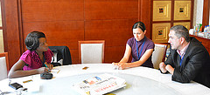
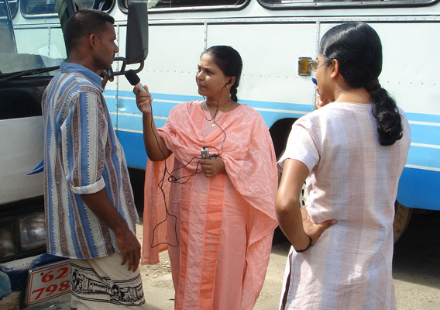
Εικόνα 16: Miriam Zimba of the Times of Zambia interviews Branislav Kapetanovic
Εικόνα 17: Amanda Bennett
Εικόνα 18: Sri Lankan woman journalist

Slide 34
Phonology-Prosody
“Women use certain patterns associated with surprise and politeness more often than men” (Brend, 1975)
“May make statements with prosody of a question (Brend, 1975)”
“Tag questions: “They caught the robber last week, didn’t they?” (Lakoff , 1973)
Εικόνα 19: Cheryl Casone

Slide 35
Vocabulary
(Lakoff , 1973)
Color words: mauve, beige, aquamarine, magenta
Adjectives: adorable, charming, divine, lovely, sweet
Emphasis-words: such fun, fantastic
“Women are also said not to employ the profanities and obscenities men use, or, if they do, use them in different circumstances or are judged differently for using them”. (Wardhaugh, 1998)

Slide 36
“Men’s speech usually provides the norm against which women’s speech is judged.” (Wardhaugh, 1998)
Εικόνα 20: Afghan journalist Friba Chalkhi Habib (L) speaks with Member of Parliament (MP) Nafisa Sultani during the "Face the Nation," television programme on public Channel RTA, in Kabul, 12 July 2007.

Slide 37
“…a woman being advised to speak more like a man…”
Margaret Thatcher was told that her voice did not match her position as British Prime Minister:
she sounded too ‘shrill’.
She was advised to lower the pitch of her voice,
diminish its range,
and speak more slowly,
and thereby adopt an authoritative, almost monotonous delivery to make herself heard.
She was successful to the extent that her new speaking style became a kind of trademark, one either well-liked by her admirers or detested by her opponents.” (Wardhaugh, 1998)

Slide 38
Texts – Sources
Photo: Internews Pakistan, Freshta Shikhany went from being an Afghan refugee in Pakistan's North West Frontier province to a reporter for Internews' radio program, Da Pulay Poray, as well as having her own radio program on Peshawar's first independent FM. Getty Images 21 months ago Afghan journalist Friba Chalkhi Habib (L) speaks with Member of Parliament (MP) Nafisa Sultani during the "Face the Nation," television programme on public Channel RTA, in Kabul, 12 July 2007.
Mexico’s Lydia Cacho, Ethiopia’s Serkalem Fasil, Zimbabwe’s Peta Thornycroft, and six Iraqi journalists from Baghdad’s McClatchy Bureau (Huda Ahmed, Shatha al Awsy, Sahar Issa, Alaa Majeed, Zaineb Obeid and Ban Adil Sarhan) comprised of the honorees. Among them, Serkalem received the IWMF Lifetime Achievement Award. Rima Abdelkader, Published 10/24/2007 - 12:35 p.m. CST
Photo: Andrea Wenzel/Internews . SRI LANKA: Journalists practice interview techniques during a workshop at the East Media House in Ampara, established by Internews in early 2007. Kamalarani Saravanan, Journalist, Ampara district
Miriam Zimba of the Times of Zambia gives her insight into the state of Zambian Journalism and the challenges faced by women journalists in her country. http://media.www.dailypennsylvanian.com/media/storage/paper882/news/2003/11/14/News/Women.Journalists.Share.Experiences.From.Careers-2153112.shtml
On her way up: Margaret Thatcher in 1961 as a junior minister http://www.dailymail.co.uk/news/article-475412/The-BBC-A-cauldron-hate-Margaret-Thatcher.html
http://jezebel.com/5013953/how-being-a-woman-in-politics-can-help-and-hurt

Slide 39
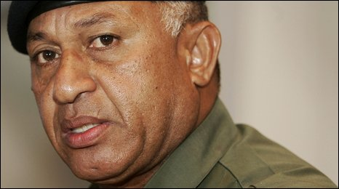
DISCUSSION: Gestures -Paralinguistic Features Zoom-In / Zoom-Out
Εικόνα 21: Commodore Frank Bainimarama

Slide 40
Gestures -Paralinguistic Features Zoom-In / Zoom-Out
Facial Expressions
Posture
Gestures
Subtitles / Attached Texts
(GESTIK, MIMIK, GESICHTSAUSDRUCK, HALTUNG, BEZIEHUNG BILD UND TEXT)

Slide 41
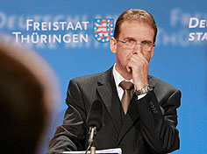
Example
Εικόνα 22: Dieter Althaus
Bildquelle dpa
Dieter Althaus gibt Pressekonferenz
Althaus nimmt Amtsgeschäfte auf
Nach Skiunfall: Thüringens Ministerpräsident räumt Schuld ein
Thüringens Ministerpräsident ist zurück. Er trage schwer an dem Skiunfall, sagte Althaus. Eine Frau war getötet worden. Er nehme die Schuld auf sich. An seinem ersten Arbeitstag richtete er den Blick aber auch nach vorn: Jetzt sei Handeln angesagt
http://www.heute.de/ZDFheute/

Slide 42
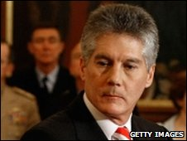
Εικόνα 23: Ma Canrong, Former Ambassador to Germany (Foto: picture-alliance / dpa)
Εικόνα 24: Australian Foreign Minister Stephen Smith

Slide 43
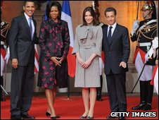
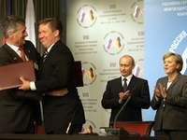
Εικόνα 25: The Obamas with the French president and his wife
Εικόνα 26: BASF-Chef Jürgen Hambrecht (li) und Gazprom-Chef Alexej Miller (re) (Foto: REUTERS)

Slide 44
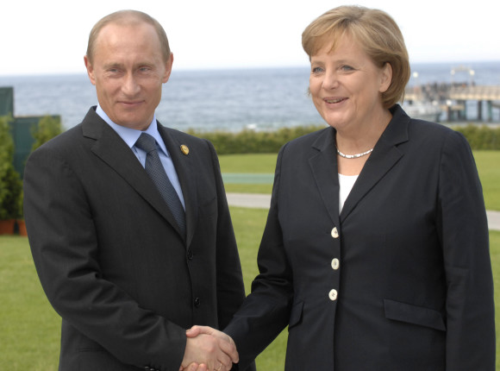
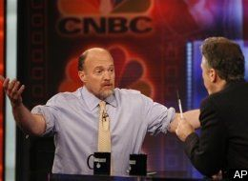
Εικόνα 27: Bundeskanzlerin Angela Merkel und der russische Präsident Wladimir Putin in Heiligendamm
Εικόνα 28: Cramer Versus Stewart

Slide 45
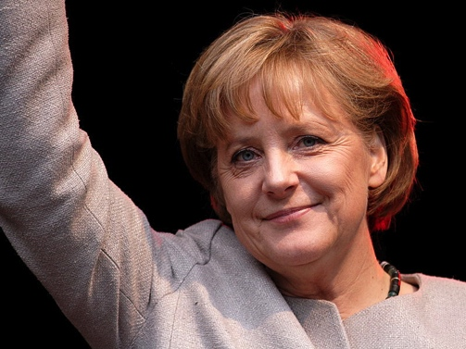
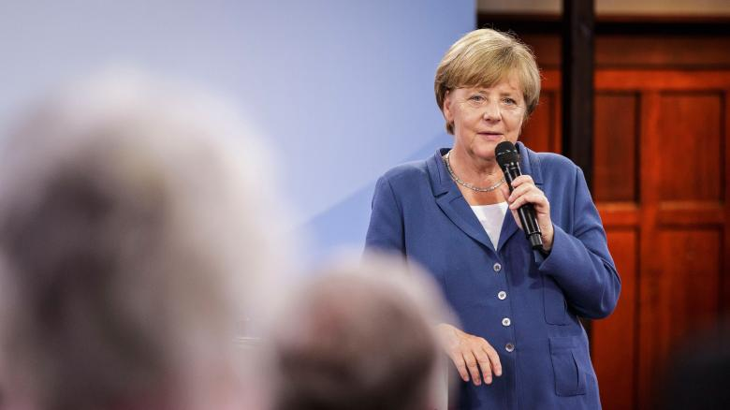
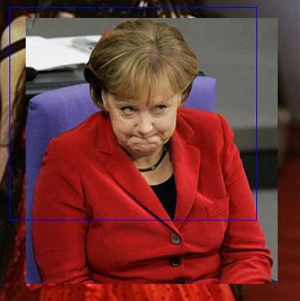
Εικόνα 29: Angela Merkel
Εικόνα 30: Angela Merkel
Εικόνα 31: Angela Merkel

Slide 46
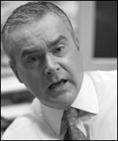
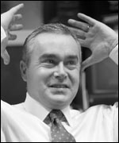
Εικόνα 32, 33, 34: Huw Edwards
Εικόνα 35: Sting interview Parkinson – BBC
Εικόνα 36: Parkinson: Michael Palin on the Origin of Monty Python
Εικόνα 37: Patrick Poivre d'Arvor , TF1 France

Slide 47
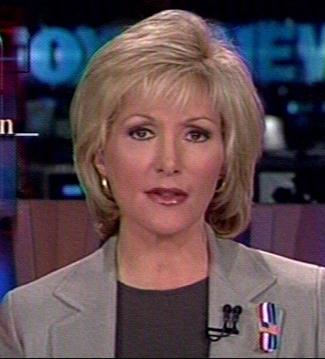
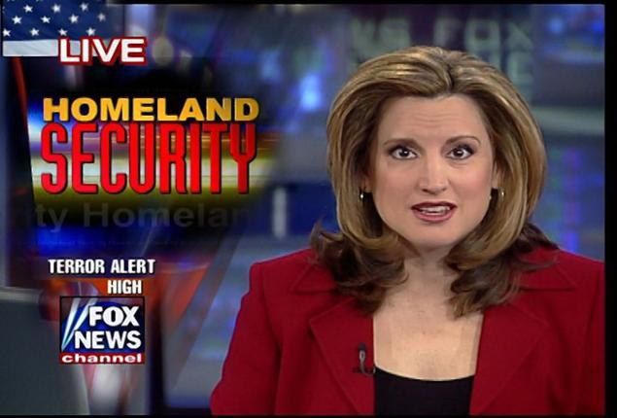
Εικόνα 38: Caroline Shively, Fox News Anchorwoman
Εικόνα 39: Donna Fiducia, Fox News Anchorwoman
Εικόνα 40: Brigitte Quinn, Fox News Anchorwoman

Slide 48
Texts-1
Commodore Frank Bainimarama is a serial interferer in Fijian politics
To suggest that an election will be held in 2014 is nothing more than a sham” Stephen Smith, Australian Foreign Minister
By Phil Mercer , BBC News, Sydney
[Bildunterschrift: Ma Canrong: "Enttäuschung über einseitige Berichterstattung der hiesigen Medien" ]
[Bildunterschrift: Applaus von Russlands Präsident Putin und Bundeskanzlerin Merkel: Die Geschäfte unter Dach und Fach (BASF-Chef Jürgen Hambrecht (li) und Gazprom-Chef Miller (re) in Tomsk) ]
Huffington Post | Nicholas Graham | April 15, 2009 at 01:48 AM
Jim Cramer is clearly still fuming from his disastrous appearance on the "The Daily Show" where he was grilled relentlessly by host Jon Stewart

Slide 49
Texts-2
Visiting Russia Angela Merkel had meeting with Dmitry Medvedev, who has been elected now as Russia’s president. “I think there will be continuity,” Ms Merkel said after meeting Mr Medvedev in Moscow on Saturday. “I do not think that the controversies will just disappear”.http://elections4us.com/2008/03/10/angela-merkel/
06.06.2007Bundeskanzlerin Merkel spricht mit russischem Präsident Putin / German Chancellor Angela Merkel meets Russian President Vladimir Putin
http://www.g8.de/Webs/G8/EN/Media/FotoDownload/blaettern028c.html?id=219354, Photo: REGIERUNGonline / Kühler Bundeskanzlerin Angela Merkel und der russische Präsident Wladimir Putin in Heiligendamm / German Chancellor Angela Merkel and Russian President Vladimir Putin in Heiligendamm
http://www.cjreport.com/news/156/german-chancellor-angela-merkel-visit-budapest.html?phpMyAdmin=20cc4929a8d1t3e136abc
REUTERS: Angela Merkel: How should I know who's going to be my coalition partner?

Slide 50
Journalists
Trevor McDonald, ITN anchorman - photo credit: BBC
BBC newsreader George Alagiah
News anchorman, Chikushi Tetsuya, TBS news program “News 23″
Huw Edwards, BBC News (The real Huw Edwards, By Lucy Wallis, BBC News Online)
Sir Michael Parkinson, BBC News
Patrick Poivre d'Arvor , TF1 France
Fox News Anchorwomen: Caroline Shively, Donna Fiducia, Brigitte Quinn

Slide 51
References
Alexandris, C., Fotinea, S-E. (2004): “Reusing Language Resources for Speech Applications involving Emotion”, in: Proceedings of the 4th LREC Conference, Lisbon, Portugal, Vol.IX, 1383-1386.
Alexandris, C., Fotinea, S-E. (2005): “Exploiting Extralinguistic Markers in Dialogue Systems in the Medical Sector”, in Proceedings of the Hellenic Society of Systemic Studies –HSSS 2005, Tripoli, Greece.
Alexandris, C. (2003). Translational Issues in the Sublanguage of Written and Spoken Journalistic Texts in Modern Greek. In: Proceedings of the International Conference on Choice and Difference in Translation, Athens 2003, 287-307.
Fairclough, N. (2001). Language and Power. Pearson Education, Upper Saddle River, NJ .
Forrester, M. (1996). Psychology of Language. SAGE Publications, Thousand Oaks, CA, USA.
Hatim, B. (1997). Communication Across Cultures: Translation Theory and Contrastive Text Linguistics, University of Exeter Press.
Wardhaugh, R. (1992). Introduction to Sociolinguistics. Oxford, Blackwell.
Wodack, R (1996). Disorders of Discourse. Longman, New York.
CIMWOS project (2000-2003). www.xanthi.ilsp.gr/cimwos

Slide 52
Tools
Interactive User interface by the New York Times: for analyzing the most recent Democratic Debate: http://www.nytimes.com/interactive/2008/02/26/us/politics/20080226_DEBATE_GRAPHIC.html#transcript
Subtitling Services by Visualsubsync: http://www.visualsubsync.org/

Slide 53
Links
http://www.heute.de/ZDFheute/
http://www.spiegel.de/politik/
http://news.bbc.co.uk/
http://english.aljazeera.net/news/europe/
http://edition.cnn.com/live/
http://www.cbsnews.com/sections/politics/

Slide 54
Τέλος Ενότητας

Slide 55
Χρηματοδότηση
Το παρόν εκπαιδευτικό υλικό έχει αναπτυχθεί στo πλαίσιo του εκπαιδευτικού έργου του διδάσκοντα.
Το έργο «Ανοικτά Ακαδημαϊκά Μαθήματα στο Πανεπιστήμιο Αθηνών» έχει χρηματοδοτήσει μόνο την αναδιαμόρφωση του εκπαιδευτικού υλικού.
Το έργο υλοποιείται στο πλαίσιο του Επιχειρησιακού Προγράμματος «Εκπαίδευση και Δια Βίου Μάθηση» και συγχρηματοδοτείται από την Ευρωπαϊκή Ένωση (Ευρωπαϊκό Κοινωνικό Ταμείο) και από εθνικούς πόρους.

Slide 56
Σημειώματα

Slide 57
Σημείωμα Ιστορικού Εκδόσεων Έργου
Το παρόν έργο αποτελεί την έκδοση 1.0.

Slide 58
Σημείωμα Αναφοράς
Copyright Εθνικόν και Καποδιστριακόν Πανεπιστήμιον Αθηνών, Χριστίνα Αλεξανδρή. «Εμπειρική Γλωσσολογική Έρευνα: Information Management in the Media/PARALINGUISTIC FEATURES in SPOKEN JOURNALISTIC TEXTS». Έκδοση: 1.0. Αθήνα 2015. Διαθέσιμο από τη δικτυακή διεύθυνση:
http://eclass.uoa.gr/courses/GS208/

Slide 59
Σημείωμα Αδειοδότησης
Το παρόν υλικό διατίθεται με τους όρους της άδειας χρήσης Creative Commons Αναφορά, Μη Εμπορική Χρήση Παρόμοια Διανομή 4.0 [1] ή μεταγενέστερη, Διεθνής Έκδοση. Εξαιρούνται τα αυτοτελή έργα τρίτων π.χ. φωτογραφίες, διαγράμματα κ.λ.π., τα οποία εμπεριέχονται σε αυτό και τα οποία αναφέρονται μαζί με τους όρους χρήσης τους στο «Σημείωμα Χρήσης Έργων Τρίτων».
[1] http://creativecommons.org/licenses/by-nc-sa/4.0/
Ως Μη Εμπορική ορίζεται η χρήση:
που δεν περιλαμβάνει άμεσο ή έμμεσο οικονομικό όφελος από την χρήση του έργου, για το διανομέα του έργου και αδειοδόχο
που δεν περιλαμβάνει οικονομική συναλλαγή ως προϋπόθεση για τη χρήση ή πρόσβαση στο έργο
που δεν προσπορίζει στο διανομέα του έργου και αδειοδόχο έμμεσο οικονομικό όφελος (π.χ. διαφημίσεις) από την προβολή του έργου σε διαδικτυακό τόπο
Ο δικαιούχος μπορεί να παρέχει στον αδειοδόχο ξεχωριστή άδεια να χρησιμοποιεί το έργο για εμπορική χρήση, εφόσον αυτό του ζητηθεί.

Slide 60
Διατήρηση Σημειωμάτων
Οποιαδήποτε αναπαραγωγή ή διασκευή του υλικού θα πρέπει να συμπεριλαμβάνει:
το Σημείωμα Αναφοράς
το Σημείωμα Αδειοδότησης
τη δήλωση Διατήρησης Σημειωμάτων
το Σημείωμα Χρήσης Έργων Τρίτων (εφόσον υπάρχει)
μαζί με τους συνοδευόμενους υπερσυνδέσμους.

Slide 61
Σημείωμα Χρήσης Έργων Τρίτων (1/8)
Το Έργο αυτό κάνει χρήση των ακόλουθων έργων:
Εικόνες/Σχήματα/Διαγράμματα/Φωτογραφίες
Εικόνα 1: Der Retter in der Not? Hartmut Mehdorn soll das Desaster um den neuen Berliner Hauptstadtflughafen lösen. (Fotos: dpa), © 2015 WeltN24 GmbH, http://www.n24.de/n24/Mediathek/Bilderserien/d/355666/mehdorn-wird-jetzt-flughafen-chef.html, Quelle: N24, 31.03.2013, date accessed: 03.09.2015
Εικόνα 2: Trevor McDonald: The face of ITN, http://news.bbc.co.uk/2/hi/uk_news/648324.stm, bbc, non-commercial use, http://news.bbc.co.uk/hi/english/static/copyright.stm, date published: 18.02.2000, date accessed: 03.09.15
Εικόνα 3: Car crashes into TV studio while host is on air, non-commercial use, http://www.bellmedia.ca/http://www.ctvnews.ca/car-crashes-into-tv-studio-while-host-is-on-air-1.268738, CTV.ca News Staff Published Monday, December 24, 2007, date accessed: 03.09.15
Εικόνα 4: ZDF-Wissenschaftsmoderator Joachim Bublath verlässt das Studio, nachdem ihn Nina Hagen (l.) mit ihren Thesen genervt hat, Foto: picture-alliance/ dpa/wdr, © WeltN24 GmbH 2015,http://www.welt.de/fernsehen/article13706774/Hella-von-Sinnen-treibt-Maischberger-in-den-Wahnsinn.html, welt.de, , date published: 09.11.11, date accessed: 03.09.15
Εικόνα 5: Margart Larsen, Rights Managed, © Annie Griffiths Belt/CORBIS, RM, http://www.corbisimages.com Manhattan, New York City, New York State, USA, date created: 01.08.1992, date accessed: 03.09.15

Slide 62
Σημείωμα Χρήσης Έργων Τρίτων (2/8)
Το Έργο αυτό κάνει χρήση των ακόλουθων έργων:
Εικόνα 6: Mohamed ElBaradei shares a laugh with Tim Sebastian, former BBC Hardtalk anchorman, before an interview. Vienna, Austria, 28 September 2004, © 1998–2014 IAEAhttp://www.iaea.org/NewsCenter/Multimedia/PhotoGallery/dgscorner/Album/images/0605web.jpg, date accessed: 03.09.15
Εικόνα 7: VisualSubSync, The subtitle program / subtitle editor, http://www.visualsubsync.org/tutorials/making-transcript, http://www.visualsubsync.org/_media/tutorials/t01_03_maindialog.png, tutorials/making-transcript.txt · Last modified: 2009/07/14 by viswhat, date accessed: 03.09.15
Εικόνα 8: VisualSubSync, The subtitle program / subtitle editor, http://www.visualsubsync.org/tutorials/making-transcript, http://www.visualsubsync.org/_media/tutorials/t01_04_maindialog2.png, Last modified: 2009/07/14 by viswhat, date accessed: 03.09.15
Εικόνα 9: VisualSubSync, The subtitle program / subtitle editor, http://www.visualsubsync.org/tutorials/making-transcript, http://www.visualsubsync.org/_media/tutorials/t01_06_homepage.png, Last modified: 2009/07/14 by viswhat, date accessed: 03.09.15

Slide 63
Σημείωμα Χρήσης Έργων Τρίτων (3/8)
Το Έργο αυτό κάνει χρήση των ακόλουθων έργων:
Εικόνα 10: VisualSubSync, The subtitle program / subtitle editor, http://www.visualsubsync.org/tutorials/making-transcript, http://www.visualsubsync.org/_media/tutorials/t01_07_detailspage.png Last modified: 2009/07/14 by viswhat, date accessed: 03.09.15
Εικόνα 11: The New York Times, Interactive User interface by the New York Times: for analyzing the most recent Democratic Debate, http://www.nytimes.com/content/help/rights/copyright/copyright-notice.htmhttp://www.nytimes.com/interactive/2008/02/21/us/politics/20080221_DEBATE_GRAPHIC.html?_r=0 , Date published: January 31, 2008, date accessed: 03.09.15
Εικόνα 12: Subtitling Services by Visualsubsync: http://www.visualsubsync.org/http://futureofthebook.org/blog/archives/nytimesdebate2.jpg Date published: January 31, 2008, date accessed: 03.09.15
Εικόνα 13: Chikushi Tetsuya, News anchorman, TBS news program “News 23″, TBS, JapanCopyright: kojaproductions.com, http://kojaproductions.wordpress.com/2008/11/07/, accessed: 13.12.14
Εικόνα 14: George Alagiah, BBC newsreader, Copyright: BBC, UK http://news.bbc.co.uk/2/hi/entertainment/4390430.stm/2005/10/30, date accessed: 13.12.14

Slide 64
Σημείωμα Χρήσης Έργων Τρίτων (4/8)
Το Έργο αυτό κάνει χρήση των ακόλουθων έργων:
Εικόνα 15: Mentoren können junge Journalistinnen ermuntern, sagt Lena Kampf (links) im Gespräch mit Moderatorin Annette Leiterer. Foto: Wulf Rohwedder150703_K3_Investigativmaennlich_wr_17a.jpg, https://netzwerkrecherche.org/wp-content/uploads/2015/07/150703_K3_Investigativmaennlich_wr_17a.jpg Datum: 04.07.2015, accessed: 15.09. 2015
Εικόνα 16: Miriam Zimba, Miriam Zimba of the Times of Zambia interviews Branislav Kapetanovic, CMC spokesperson and cluster munition survivor, https://www.flickr.com/photos/clustermunitioncoalition/9783598534, Taken on September 10, 2013 , Some rights reserved , accessed: 15.09. 2015
Εικόνα 17: Amanda Bennett. When death is the enemy, what is victory? 2013 http://www.tedmed.com/speakers/show?id=75322 , accessed: 15.09. 2015
Εικόνα 18: Photo: Andrea Wenzel/Internews . SRI LANKA: Journalists practice interview techniques during a workshop at the East Media House in Ampara, established by Internews in early 2007. Kamala Rani Saravanan, Journalist, Ampara district
Εικόνα 19: Cheryl Casone,’92, © 2015 Arizona Board of Regents. Northern Arizona University, Flagstaff, Arizonahttps://www.nau.edu/uploadedImages/Administrative/University_Advancement_Sites/Alumni/_Media/Nov_2012_Facetime/Cheryl%20Casone,%E2%80%9992%20BS.jpg, accessed: 15.09. 2015

Slide 65
Σημείωμα Χρήσης Έργων Τρίτων (5/8)
Το Έργο αυτό κάνει χρήση των ακόλουθων έργων:
Εικόνα 20: Internews Pakistan- Afghan journalist Friba Chalkhi Habib (L) speaks with Member of Parliament (MP) Nafisa Sultani during the "Face the Nation," television programme on public Channel RTA, in Kabul, 12 July 2007. AFP PHOTO/SHAH Marai (Photo credit should read SHAH MARAI/AFP/Getty Images)
Εικόνα 21: Democratic future fades for Fiji, Copyright © 2015 BBC, http://news.bbc.co.uk/2/hi/asia-pacific/7996581.stm, bbc, day published: 13. 04. 2009, date accessed: 04.09.2015
Εικόνα 22: Dieter Althaus, Bildquelle dpa© RP Digital http://bc02.rp-online.de/polopoly_fs/thueringische-ministerpraesident-dietalth110-tage-sschweren-skiunfall-1.2234035.1317768757!httpImage/3079373202.jpg_gen/derivatives/d540x303/3079373202.jpg, , date accessed: 04.09.2015
Εικόνα 23: Botschafter zu manipulierter ts.de-Umfrage , 15.04.08, http://www.tagesschau.de/ausland/china128~magnifier_pos-0.html, Ma Canrong: "Enttäuschung über einseitige Berichterstattung der hiesigen Medien" | Bildquelle: picture-alliance / dpa, , date accessed: 04.09.2015
Εικόνα 24: Stephen Smith Australian Foreign Minister, Copyright © 2015 BBC, Australian Foreign Minister Stephen Smith, date published: 13 April 2009, date accessed: 04.09.2015

Slide 66
Σημείωμα Χρήσης Έργων Τρίτων (6/8)
Το Έργο αυτό κάνει χρήση των ακόλουθων έργων:
Εικόνα 25: Mr Obama appears to stand head and shoulders above other leaders. © BBC 2015, http://news.bbc.co.uk/2/hi/7989433.stm, Published: 2009/04/09, , date accessed: 04.09.2015
Εικόνα 26: Applaus von Russlands Präsident Putin und Bundeskanzlerin Merkel: Die Geschäfte unter Dach und Fach (BASF-Chef Jürgen Hambrecht (li) und Gazprom-Chef Miller (re) in Tomsk) , © ARD-aktuell / tagesschau.de, https://www.tagesschau.de/wirtschaft/meldung92714~magnifier_pos-2.html, Bildquelle: REUTERS, Stand: 06.05.2006, accessed: 05.09.2015
Εικόνα 27: Bundeskanzlerin Angela Merkel und der russische Präsident Wladimir Putin in Heiligendamm, © Press and Information Office of the Federal Governmenthttp://www.g-8.de/Webs/G8/EN/Media/FotoDownload/blaettern028c.html?id=219354, Photo: REGIERUNGonline / Kühler, published: 06.06.2007 , accessed: 05.09.2015
Εικόνα 28: CNBC Mad Money's host Jim Cramer in an interview with Comedy Central's The Daily Show's Host John Stewart, Copyright © 2015 TheHuffingtonPost.com, Inc. http://www.huffingtonpost.com/the-news/2009/04/14/, Huffington Post, Courtesy, CNBC,published: May 15, 2009 accessed: 05.09.2015
Εικόνα 29: "Angela Merkel (2008)" by א (Aleph) - Own work. Licensed under CC BY-SA 2.5 via Commons - https://commons.wikimedia.org/wiki/File:Angela_Merkel_(2008).jpg#/media/File:Angela_Merkel_(2008).jpg, accessed: 05.09.2015

Slide 67
Σημείωμα Χρήσης Έργων Τρίτων (7/8)
Το Έργο αυτό κάνει χρήση των ακόλουθων έργων:
Εικόνα 30: Kanzlerin Angela Merkel wirbt bei einem Bürgerdialog im Duisburger Problemviertel Marxloh dafür, Migranten besser zu integrieren und Deutschland auch als deren Heimatland anzuerkennen. Quelle: N24http://img.welt.de/img/videos/crop145623711/0779403078-ci16x9-w780/German-Chancellor-Angela-Merkel-At-The-Living-Well-In-Germany-Event-In-Marxloh.jpg
Εικόνα 31: Angela Merkel, Business Insider Inc. Copyright © 2015 Business Insider Inchttp://www.businessinsider.com/merkel-sarkozy-pact-for-stability-opposition-2011-2?IR=T, 06.02. 2011, accessed: 05.09.2015
Εικόνα 32: The real Huw Edwards <άδεια με την οποία διατίθεται, http://news.bbc.co.uk/2/hi/programmes/ten/2655339.stm, BBC News Online, © BBC 2015, Photographs by Phil Coomes, published: 18.12.2003, date accessed: 02.09.2015
Εικόνα 33: The real Huw Edwards <άδεια με την οποία διατίθεται, http://news.bbc.co.uk/2/hi/programmes/ten/2655339.stm, BBC News Online, © BBC 2015, Photographs by Phil Coomes, published: 18.12.2003. date accessed: 02.09.2015
Εικόνα 34: The real Huw Edwards, http://news.bbc.co.uk/2/hi/programmes/ten/2655339.stm, BBC News Online, © BBC 2015, Photographs by Phil Coomes, published: 18.12.2003, date accessed: 02.09.2015

Slide 68
Σημείωμα Χρήσης Έργων Τρίτων (8/8)
Το Έργο αυτό κάνει χρήση των ακόλουθων έργων:
Εικόνα 35: Sting interview - part two - Parkinson – BBC, Standard YouTube License://www.youtube.com/watch?v=HWID3OUgufk, YouTube, BBCWorldwide, Uploaded on Dec 12, 2007, date accessed: 02.09.2015
Εικόνα 36: Parkinson: Michael Palin on the Origin of Monty Python http://www.liveleak.com/view?i=b4c_1289366453#bffebdrhhWj1X5CZ.99, http://www.liveleak.com/copyright, http://www.liveleak.com/view?i=b4c_1289366453, published: Nov-10-2010 , date accessed: 02.09.2015
Εικόνα 37: Patrick Poivre d'Arvor , TF1 France, © 2008 AFP, http://www.ladepeche.fr/article/2008/07/10/463637-le-dernier-journal-televise-de-ppda.html, ©ladepeche.fr, date publishe: 10/07/2008, date accessed: 02.09.2015
Εικόνα 38: Caroline Shively, © 2003-2015 TV Newsroomhttp://tvnewsroom.org/images/news-staff/caroline-shively/caroline-shively-Image-001.jpg, date accessed: 02.09.2015
Εικόνα 39: Donna Fiducia, http://www.kapturedforyou.com/May02/053002/donna0530b.jpg, modified: May 27, 2011, date accessed: 02.09.2015
Εικόνα 40: Brigitte Quinn, © Copyright 2015 NYDailyNews.com,http://www.nydailynews.com/news/national/murdered-reporters-job-hides-danger-article-1.2338485, date accessed: 22.09.2015

Slide 69
Σημείωμα Χρήσης Έργων Τρίτων (2/2)
Το Έργο αυτό κάνει χρήση των ακόλουθων έργων:
Πίνακες

