Slide 1
Applied Linguistics to Foreign Language Teaching and Learning
Unit 4: Foreign Language Knowledge and Course Planning
Bessie Dendrinos
School of Philosophy
Faculty of English Language and Literature

Slide 2
Questions/issues addressed in this unit
What kinds of knowledge does a language user need to have in order to use the language effectively?
What is competence and performance?
What is communicative competence?
What is declarative and procedural knowledge?
Is competence related to performance?
What is participatory and official knowledge?
What is our starting point in language course design?

Slide 3
Our goal as language teachers
To help students learn a second language in the classroom setting and become proficient in that language.
What does proficient mean?
How does one achieve proficiency?
What does “knowing” a language mean? What knowledge/skills does one need to have in order to be proficient in a language?

Slide 4
What proficiency is not…
What proficiency is NOT:
It is not a theory of language acquisition.
It is not a method of language instruction.
It is not a syllabus or an outline to inform our curricula.
It is not a preoccupation with grammar or accuracy.
So, what is it?

Slide 5
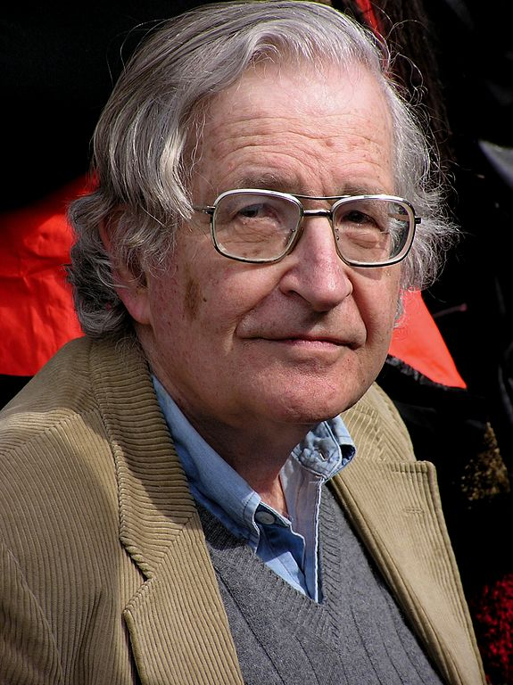
Competence and performance: Historical developments
Chomsky (1965) was the first to distinguish between a speaker’s competence and his/her performance:
Competence is what you know.
Performance is what you do.
[1]

Slide 6
Competence
Competence refers to the implicit knowledge a native speaker has of linguistics rules (usage)of his language.
This knowledge has been internalised in childhood.
This knowledge enables a native speaker to produce and understand grammatically correct sentences.

Slide 7
Performance
Performance refers to the actual use of the language.
Performance is contaminated and impure (influenced by memory limitations, distractions, errors, false starts, etc.) and does not reflect a speaker’s underlying competence.

Slide 8
Communicative competence (1/2)
Hymes (1960s) regarded Chomsky’s definition of competence as restrictive.
He introduced the distinction between “sociolinguistic (or contextual) competence” and “linguistic (or grammatical) competence”.
Linguistic competence is part of one’s communicative competence.

Slide 9
Communicative competence (2/2)
Hymes maintains that a proficient speaker has internalised linguistic rules (what is grammatical and what is not).
S/he has also internalised social rules of language use; s/he knows when to speak or write, to whom and how, s/he knows how to talk and write appropriately.
A proficient speaker knows that his/her linguistic choices depend on the context of situation (setting, participants, purpose, channel and topic).

Slide 10
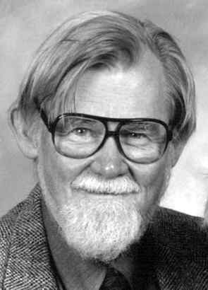
Hymes and Communicative Competence
Communicative Competence encompasses both knowledge of usage and use of language.
[2]

Slide 11
Communicative competence language teaching (1/2)
The concept of communicative competence was introduced into language teaching.
Communicative competence refers to the different kinds of knowledge a learner needs to develop in order to be able to communicate effectively in a language.

Slide 12
Communicative competence language teaching (2/2)
Canale & Swain (1980) attempted to clarify the notion of communicative competence by establishing a framework that consisted of four major components:
Grammatical competence,
Sociolinguistic competence,
Discourse competence,
Strategic competence.

Slide 13
Components of communicative competence (1/2)
Linguistic or Grammatical competence | Knowledge of language forms and their meaning; i.e. knowledge of the form and meaning of words, how words form grammatically correct (and meaningful) sentences, as well as knowledge of how to pronounce and spelling words.
Sociolinguistic or Pragmatic competence | Knowledge of the social rules of language and discourse. Language users’ ability to: select language which is contextually appropriate, understand the intended meaning (illocutionary force) of utterances.

Slide 14
Components of communicative competence (2/2)
Discourse competence | Knowledge of how to use language, given the discursive context to articulate socially meaningful speech or writing (e.g. political discourse, legal discourse, advertising discourse), which: is cohesive and coherence, follows the rules of use of a specific text type (genre) .
Strategic competence | Knowledge of communication strategies to enhance the effectiveness of communication or to compensate for communication breakdowns (e.g. use of paraphrase, word-coinage, repetition, appeals for help).

Slide 15
Faerch, Kasper and Phillipson (1986)
1
Linguistic
Pragmatic
Strategic competence
2
Fluency
3
Performance

Slide 16
Fluency vs. Accuracy
Fluency:
Ability to produce written and spoken language with ease.
Ability to communicate ideas effectively.
Ability to produce continuous speech without tiring the listener, without causing comprehension difficulties or breakdown in communication.
Accuracy:
Ability to produce grammatically correct sentences.

Slide 17
Framework of Communicative Language Ability
Language Competence
Organisational Competence
Grammatical Competence
Textual Competence
Pragmatic Competence
Illocutionary Competence
Sociolinguistic Competence

Slide 18
Framework of Communicative Language Ability
Organisational knowledge:
how utterances/sentences and texts are organised.
Pragmatic knowledge:
relationships between the forms of utterances, sentences and texts and the user’s communicative goals and the setting of language use.
(Bachman, 1990)

Slide 19
Bachman’s Model: Pragmatic Competence
Illocutionary knowledge (functional knowledge).
Ideational function: intended to convey ideas and express people’s experiences of the real world.
Manipulative function: intended to persuade or dissuade (used to affect the world around them).
Heuristic function: intended to explore ideas and feelings and to extend people’s knowledge of the world around them.
Imaginative function: where language is used creatively for aesthetic or humorous purposes.

Slide 20
Bachman’s Model: Sociolinguistic Competence
Sensitivity to register and genre.
Sensitivity to dialect or variety.
Sensitivity to “naturalness” (i.e., appropriateness).
Cultural references and figures of speech.

Slide 21
Declarative and Procedural Knowledge (1/2)
Declarative knowledge: Knowing about something.
Procedural knowledge: Knowing how to do something.

Slide 22
Declarative and Procedural Knowledge (2/2)
Does knowing about a language mean that we are able to use it?
Is one type of knowledge more important than the other?
Is the goal of foreign language teaching to produce users of the language or literate users of the language (who can also talk about the language and its use)?

Slide 23
Competence and performance
Competence: knowledge of; ability to do something.
Performance: actually doing it.
Does having the ability to do something mean that we can actually do it?
What do we assess in tests?

Slide 24
Starting points in course design (1/4)
In order to decide what knowledge is to be included in a course, the course designer has two options to start from:
The language: looking at the totality of language and trying to identify what needs to be taught and learnt.
The learner: who the learner is and what s/he needs to use the language for.

Slide 25
Starting points in course design (2/4)
Depending on the starting point the course, the designer will ask two different questions.
Question 1: What must EFL learners know about English and which skills must they have developed in order for them to communicate successfully?
Likely answer: They must know how the English linguistic system operates and they must have developed the skills to understand and produce spoken and written English.

Slide 26
Starting points in course design (3/4)
Question 2: What will the EFL learners/users need to do with the language; that is, what will they be using English for?
Likely answer: It depends on who the learners/users are and what their sociocultural context is.

Slide 27
Starting points in course design (4/4)
How will the starting point affect what gets included in a course?
There is no universal conception of what knowledge in a foreign language entails. It all depends on what your starting point is – the language or the learners.

Slide 28
References
Bachman, L. F. (1990). Fundamental considerations in language testing. Oxford University Press.
Canale, M., & Swain, M. (1980). Theoretical bases of communicative approaches to second language teaching and testing. Applied Linguistics,1, 1-47.
Chomsky, Noam (1965), Aspects of the Theory of Syntax, Cambridge, Massachusetts: MIT Press.
Færch, C., Haastrup, K., & Phillipson, R. (1986). The role of comprehension in second language learning. Applied Linguistics, 7, 257-74.
Hymes, D. (1970). On communicative competence. In Gumpertz, J.J. & Hymes, D. (eds.) Directions in Sociolinguistics. New York: Holt, Rinehart & Winston.

Slide 29
End of Unit

Slide 30
Financing
The present educational material has been developed as part of the educational work of the instructor.
The project “Open Academic Courses of the University of Athens” has only financed the reform of the educational material.
The project is implemented under the operational program “Education and Lifelong Learning” and funded by the European Union (European Social Fund) and National Resources.

Slide 31
Notes

Slide 32
Note on History of Published Version
The present work is the edition 1.0.

Slide 33
Reference Note
Copyright National and Kapodistrian University of Athens, Bessie Dendrinos. Bessie Dendrinos. “Applied Linguistics to Foreign Language Teaching and Learning. Foreign Language Knowledge and Course Planning”. Edition: 1.0. Athens 2014. Available at: http://opencourses.uoa.gr/courses/ENL6/.

Slide 34
Licensing Note
The current material is available under the Creative Commons Attribution-NonCommercial-ShareAlike 4.0 International license or later International Edition. The individual works of third parties are excluded, e.g. photographs, diagrams etc. They are contained therein and covered under their conditions of use in the section «Use of Third Parties Work Note».
[1] http://creativecommons.org/licenses/by-nc-sa/4.0/
As Non-Commercial is defined the use that:
Does not involve direct or indirect financial benefits from the use of the work for the distributor of the work and the license holder.
Does not include financial transaction as a condition for the use or access to the work.
Does not confer to the distributor and license holder of the work indirect financial benefit (e.g. advertisements) from the viewing of the work on website .
The copyright holder may give to the license holder a separate license to use the work for commercial use, if requested.

Slide 35
Preservation Notices
Any reproduction or adaptation of the material should include:
the Reference Note,
the Licensing Note,
the declaration of Notices Preservation,
the Use of Third Parties Work Note (if available)
together with the accompanied URLs.

Slide 36
Note of use of third parties work
This work makes use of the following works :
Images/Figures/Diagrams/Photographs
Image 1: Noam Chomsky, Creative Commons Attribution-NonCommercial 2.0 Generic, Duncan Rawlinson, Flickr.
Image 2: Dell Hymes, Copyright Anthropological Association, All right reserved.

